Slide 1
CMSC424: Database Design Module: Relational Model; SQL
Instructor: Amol Deshpande
amol@umd.edu

Slide 2
CMSC424: Database Design Module: Relational Model + SQL
Relational Model
Instructor: Amol Deshpande
amol@cs.umd.edu

Slide 3
Relational Model
Book Chapters (6th Edition)
2.1, 2.2, 2.4
Key Topics
Relational Model Key Concepts
Domains of Table Attributes
Null Values
Schema Diagrams

Slide 4
Relational Data Model
Introduced by Ted Codd (late 60’s – early 70’s)
Before = “Network Data Model” (Cobol as DDL, DML)
Very contentious: Database Wars (Charlie Bachman vs. Ted Codd)
Relational data model contributes:
Separation of logical, physical data models (data independence)
Declarative query languages
Formal semantics
Query optimization (key to commercial success)
1st prototypes:
Ingres → CA
Postgres → Illustra → Informix → IBM
System R → Oracle, DB2

Slide 5
Key Abstraction: Relation
bname | acct_no | balance
Downtown Brighton Brighton | A-101 A-201 A-217 | 500 900 500
Account =
Terms:
Tables (aka: Relations)
Why called Relations?
Closely correspond to mathematical concept of a relation

Slide 6
Relations
bname | acct_no | balance
Downtown Brighton Brighton | A-101 A-201 A-217 | 500 900 500
Account =
Considered equivalent to…
{ (Downtown, A-101, 500),
(Brighton, A-201, 900),
(Brighton, A-217, 500) }
Relational database semantics defined in terms of mathematical relations

Slide 7
Relations
bname | acct_no | balance
Downtown Brighton Brighton | A-101 A-201 A-217 | 500 900 500
Account =
Considered equivalent to…
{ (Downtown, A-101, 500),
(Brighton, A-201, 900),
(Brighton, A-217, 500) }
Terms:
Tables (aka: Relations)
Rows (aka: tuples)
Columns (aka: attributes)
Schema (e.g.: Acct_Schema = (bname, acct_no, balance))

Slide 8
Definitions
Relation Schema (or Schema)
A list of attributes and their domains
E.g. account(account-number, branch-name, balance)
Relation Instance
A particular instantiation of a relation with actual values
Will change with time
Programming language equivalent: A variable (e.g. x)
bname | acct_no | balance
Downtown Brighton Brighton | A-101 A-201 A-217 | 500 900 500
Programming language equivalent: Value of a variable

Slide 9
Definitions
Domains of an attribute/column
The set of permitted values
e.g., bname must be String, balance must be a positive real number
We typically assume domains are atomic, i.e., the values are treated as indivisible (specifically: you can’t store lists or arrays in them)
Null value
A special value used if the value of an attribute for a row is:
unknown (e.g., don’t know address of a customer)
inapplicable (e.g., “spouse name” attribute for a customer)
withheld/hidden
Different interpretations all captured by a single concept – leads to major headaches and problems

Slide 10
Tables in a University Database
classroom(building, room_number, capacity)
department(dept_name, building, budget)
course(course_id, title, dept_name, credits)
instructor(ID, name, dept_name, salary)
section(course_id, sec_id, semester, year, building,
room_number, time_slot_id)
teaches(ID, course_id, sec_id, semester, year)
student(ID, name, dept_name, tot_cred)
takes(Id, course_id, sec_id, semester, year, grade)
advisor(s_ID, i_ID)
time_slot(time_slot_id, day, start_time, end_time)
prereq(course_id, prereq_id)

Slide 11
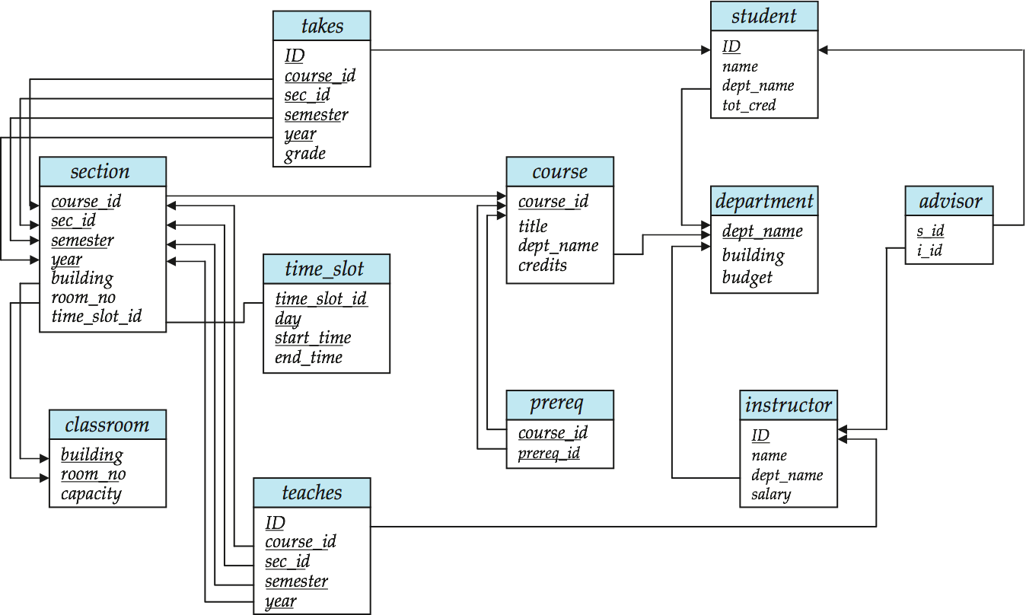
Schema Diagram for University Database

Slide 12
Schema Diagram for University Database
Primary Keys
Unique within a relation instance
i.e., no two tuples with the same value
For “prereq”: combination of course_id, and prereq_id is unique
Foreign Keys
Used to connect tuples across relations

Slide 13
Referential Integrity
Shouldn’t have undefined or “dangling” connections (aka pointers)
e.g., what if there is no “History” tuple in ”department”?
Significant consistency issue with many NoSQL systems
RDBMS typically enforce this (if defined at schema level)
Instructor relation

Slide 14
CMSC424: Database Design Module: Relation Model + SQL
SQL: Basics and DDL
Instructor: Amol Deshpande
amol@cs.umd.edu

Slide 15
SQL Basics and DDL
Book Chapters (6th Edition)
3.1, 3.2
Key Topics
SQL Overview
How to create relations using SQL
How to insert/delete/update tuples

Slide 16
History
IBM Sequel language developed as part of System R project at the IBM San Jose Research Laboratory
Renamed Structured Query Language (SQL)
ANSI and ISO standard SQL:
SQL-86, SQL-89, SQL-92
SQL:1999, SQL:2003, SQL:2008
Commercial systems offer most, if not all, SQL-92 features, plus varying feature sets from later standards and special proprietary features.
Not all examples here may work on your particular system.
Several alternative syntaxes to write the same queries

Slide 17
Different Types of Constructs
Data definition language (DDL): Defining/modifying schemas
Integrity constraints: Specifying conditions the data must satisfy
View definition: Defining views over data
Authorization: Who can access what
Data-manipulation language (DML): Insert/delete/update tuples, queries
Transaction control:
Embedded SQL: Calling SQL from within programming languages
Creating indexes, Query Optimization control…

Slide 18
Data Definition Language
The SQL data-definition language (DDL) allows the specification of information about relations, including:
The schema for each relation.
The domain of values associated with each attribute.
Integrity constraints
Also: other information such as
The set of indices to be maintained for each relations.
Security and authorization information for each relation.
The physical storage structure of each relation on disk.

Slide 19
SQL Constructs: Data Definition Language
CREATE TABLE <name> ( <field> <domain>, … )
create table department
(dept_name varchar(20),
building varchar(15),
budget numeric(12,2) check (budget > 0),
primary key (dept_name)
);
create table instructor (
ID char(5), name varchar(20) not null, dept_name varchar(20), salary numeric(8,2),
primary key (ID), foreign key (dept_name) references department
)

Slide 20
SQL Constructs: Data Definition Language
CREATE TABLE <name> ( <field> <domain>, … )
create table department
(dept_name varchar(20) primary key,
building varchar(15),
budget numeric(12,2) check (budget > 0)
);
create table instructor (
ID char(5) primary key,
name varchar(20) not null, d_name varchar(20), salary numeric(8,2), foreign key (d_name) references department
)

Slide 21
SQL Constructs: Data Definition Language
drop table student
delete from student
Keeps the empty table around
alter table
alter table student add address varchar(50);
alter table student drop tot_cred;

Slide 22
SQL Constructs: Insert/Delete/Update Tuples
INSERT INTO <name> (<field names>) VALUES (<field values>)
insert into instructor values (‘10211’, ’Smith’, ’Biology’, 66000);
insert into instructor (name, ID) values (‘Smith’, ‘10211’);
-- NULL for other two
insert into instructor (ID) values (‘10211’);
-- FAIL
DELETE FROM <name> WHERE <condition>
delete from department where budget < 80000;
Syntax is fine, but this command may be rejected because of referential integrity constraints.

Slide 23
SQL Constructs: Insert/Delete/Update Tuples
DELETE FROM <name> WHERE <condition>
delete from department where budget < 80000;
We can choose what happens:
Reject the delete, or
Delete the rows in Instructor (may be a cascade), or
Set the appropriate values in Instructor to NULL
Instructor relation

Slide 24
SQL Constructs: Insert/Delete/Update Tuples
DELETE FROM <name> WHERE <condition>
delete from department where budget < 80000;
create table instructor
(ID varchar(5),
name varchar(20) not null,
dept_name varchar(20),
salary numeric(8,2) check (salary > 29000),
primary key (ID),
foreign key (dept_name) references department
on delete set null
);
We can choose what happens:
Reject the delete (nothing), or
Delete the rows in Instructor (on delete cascade), or
Set the appropriate values in Instructor to NULL (on delete set null)

Slide 25
SQL Constructs: Insert/Delete/Update Tuples
DELETE FROM <name> WHERE <condition>
Delete all classrooms with capacity below average
delete from classroom where capacity <
(select avg(capacity) from classroom);
Problem: as we delete tuples, the average capacity changes
Solution used in SQL:
First, compute avg capacity and find all tuples to delete
Next, delete all tuples found above (without recomputing avg or retesting the tuples)
E.g. consider the query: delete the smallest classroom

Slide 26
SQL Constructs: Insert/Delete/Update Tuples
UPDATE <name> SET <field name> = <value> WHERE <condition>
Increase all salaries’s over $100,000 by 6%, all other receive 5%.
Write two update statements:
update instructor set salary = salary ∗ 1.06 where salary > 100000;
update instructor set salary = salary ∗ 1.05 where salary ≤ 10000;
The order is important
Can be done better using the case statement

Slide 27
SQL Constructs: Insert/Delete/Update Tuples
UPDATE <name> SET <field name> = <value> WHERE <condition>
Increase all salaries’s over $100,000 by 6%, all other receive 5%.
Can be done better using the case statement
update instructor set salary =
case
when salary > 100000
then salary ∗ 1.06
when salary <= 100000
then salary ∗ 1.05
end;

Slide 28
CMSC424: Database Design Module: Relation Model + SQL
SQL: Querying Basics
Instructor: Amol Deshpande
amol@cs.umd.edu

Slide 29
SQL Querying Basics
Book Chapters (6th Edition)
3.3
Key Topics
Single-table Queries in SQL
Multi-table Queries using Cartesian Product
Difference between Cartesian Product and “Natural Join”
Careful with using “natural join” keyword

Slide 30
Basic Query Structure
Attributes or expressions
select A₁, A₂, ..., A_{n} from r₁, r₂, ..., r_{m} where P
Relations (or queries returning tables)
Predicates
Find the names of all instructors: select name from instructor

Slide 31
Basic Query Structure
Attributes or expressions
select A₁, A₂, ..., A_{n} from r₁, r₂, ..., r_{m} where P
Relations (or queries returning tables)
Predicates
Find the names of all instructor departments: select dept_name from instructor

Slide 32
Basic Query Structure
Attributes or expressions
select A₁, A₂, ..., A_{n} from r₁, r₂, ..., r_{m} where P
Relations (or queries returning tables)
Predicates
Remove duplicates: select distinct name from instructor
Order the output:
select distinct name from instructor
order by name asc
Find the names of all instructors: select name from instructor
Apply some filters (predicates):
select name from instructor
where salary > 80000 and dept_name = ‘Finance’;

Slide 33
Basic Query Constructs
Select all attributes: select * from instructor
Expressions in the select clause:
select name, salary < 100000 from instructor
Find the names of all instructors: select name from instructor
More complex filters:
select name from instructor
where (dept_name != ‘Finance’ and salary > 75000)
or (dept_name = ‘Finance’ and salary > 85000);
A filter with a subquery:
select name from instructor
where dept_name in (select dept_name from
department where budget < 100000);

Slide 34
Python Equivalent
More complex filters:
select name from instructor
where (dept_name != ‘Finance’ and salary > 75000)
or (dept_name = ‘Finance’ and salary > 85000);
instructor = [ (10101, ‘Srinivasan’, 65000, ‘Comp. Sci.’),
(12121, ‘Wu’, 90000, ‘Finance’), …]
for t in instructor:
if (t[3] != ‘Finance’ and t[2] > 75000) or
(t[3] = ‘Finance’ and t[2] > 85000):
print(t[1])

Slide 35
Basic Query Constructs
Renaming tables or output column names: select i.name, i.salary * 2 as double_salary from instructor i
where i.salary < 80000 and i.name like ‘%g_’;
Find the names of all instructors: select name from instructor
More complex expressions:
select concat(name, concat(‘, ’, dept_name))
from instructor;
Careful with NULLs:
select name from instructor
where salary < 100000 or salary >= 100000;
Wouldn’t return the instructor with NULL salary (if any)

Slide 36
Multi-table Queries
Cartesian product:
select * from instructor, teaches
for i in instructor:
for t in teaches:
print(i + t)

Slide 37
Multi-table Queries
Use predicates to only select “matching” pairs: select * from instructor i, teaches t
where i.ID = t.ID;
Cartesian product:
select * from instructor, teaches
Identical (in this case) to using a natural join:
select * from instructor natural join teaches;

Slide 38
Multi-table Queries
for i in instructor:
for t in teaches:
if i.ID == t.ID:
print(i + t)
select * from instructor natural join teaches
With one ID column removed

Slide 39
Multi-table Queries
Use predicates to only select “matching” pairs: select * from instructor i, teaches t
where i.ID = t.ID;
Cartesian product:
select * from instructor, teaches
Identical (in this case) to using a natural join:
select * from instructor natural join teaches;
Natural join does an equality on common attributes – doesn’t work here:
select *
from instructor natural join advisor;
Instead can use “on” construct (or where clause as above):
select *
from instructor join advisor on (i_id = id);

Slide 40
Multi-table Queries
3-Table Query to get a list of instructor-teaches-course information:
select i.name as instructor_name, c.title as course_name from instructor i, course c, teaches
where i.ID = teaches.ID and c.course_id = teaches.course_id;
Beware of unintended common names (happens often)
You may think the following query has the same result as above – it doesn’t
select name, title from instructor natural join course natural join teaches;
I prefer avoiding “natural joins” for that reason
Note: On the small dataset, the above two have the same answer, but not on the large dataset.
Large dataset has cases where an instructor teaches a course from a different department.

Slide 41
CMSC424: Database Design Module: Relation Model + SQL
SQL: Aggregates
Instructor: Amol Deshpande
amol@cs.umd.edu

Slide 42
SQL Aggregates
Book Chapters (6th Edition)
3.7.1-3.7.3
Key Topics
Basic aggregates
Aggregation with “grouping”
“Having” clause to select among groups

Slide 43
Aggregates
Other common aggregates:
max, min, sum, count, stdev, …
select count (distinct ID) from teaches where semester = ’Spring’ and year = 2010
Find the average salary of instructors in the Computer Science
select avg(salary) from instructor
where dept_name = ‘Comp. Sci’;
Can specify aggregates in any query.
Find max salary over instructors teaching in S’10.
select max(salary) from teaches natural join instructor where semester = ’Spring’ and year = 2010;
Aggregate result can be used as a scalar.
Find instructors with max salary:
select * from instructor where salary = (select max(salary) from instructor);

Slide 44
Aggregates
Aggregate result can be used as a scalar.
Find instructors with max salary:
select * from instructor where salary = (select max(salary) from instructor);
Following doesn’t work:
select * from instructor where salary = max(salary);
select name, max(salary)
from instructor where salary = max(salary);

Slide 45
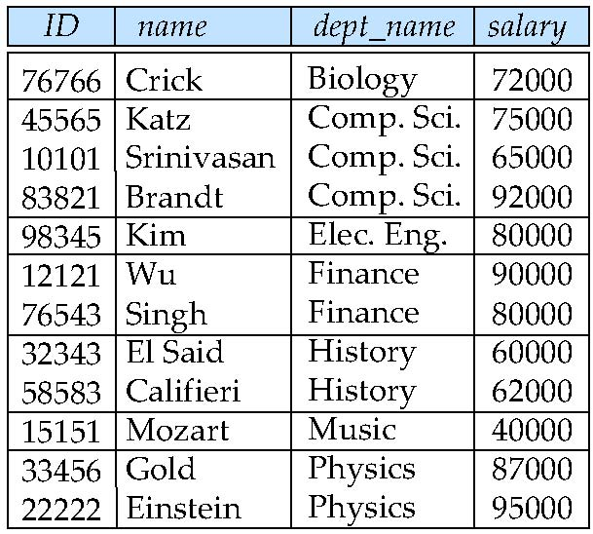
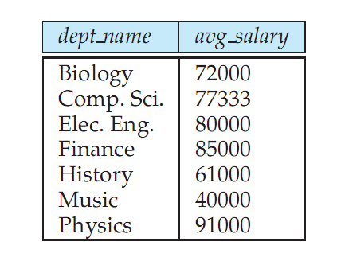
Aggregates: Group By
Split the tuples into groups, and computer the aggregate for each group
select dept_name, avg (salary) from instructor group by dept_name;

Slide 46
Aggregates: Group By
Split the tuples into groups, and computer the aggregate for each group
select dept_name, avg (salary) from instructor group by dept_name;
instructor = [ (10101, ‘Srinivasan’, 65000, ‘Comp. Sci.’),
(12121, ‘Wu’, 90000, ‘Finance’), …]
dept_names = set ( [t[3] for t in instructor] )
for dept_name in dept_names:
this_group = [t for t in instructor if t[3] == dept_name]
this_avg = average ( [t[2] for t in this_group] )
print(“{} - {}”.format(dept_name, this_avg))

Slide 47
Aggregates: Group By
Find the number of instructors in each department who teach a course in the Spring 2010 semester.
Partial Query 1:
select
from instructor natural join teaches
where semester = ‘Spring’ and year = 2010

Slide 48
Aggregates: Group By
Find the number of instructors in each department who teach a course in the Spring 2010 semester.
Partial Query 2:
select dept_name, count(*)
from instructor natural join teaches
where semester = ‘Spring’ and year = 2010
group by dept_name
Doesn’t work – double counts “Katz” who teaches twice in Spring 2010
Final:
select dept_name, count(distinct ID)
from instructor natural join teaches
where semester = ‘Spring’ and year = 2010
group by dept_name

Slide 49
Aggregates: Group By
Attributes in the select clause must be aggregates, or must appear in the group by clause. Following wouldn’t work
select dept_name, ID, avg (salary) from instructor group by dept_name;
“having” can be used to select only some of the groups.
select dept_name, avg (salary) from instructor group by dept_name
having avg(salary) > 42000;

Slide 50
CMSC424: Database Design Module: Relation Model + SQL
SQL: Different Types of Joins, and Set Operations
Instructor: Amol Deshpande
amol@cs.umd.edu

Slide 51
SQL Querying Basics
Book Chapters (6th Edition)
4.1, 3.5
Key Topics
Outer Joins
Anti-joins, Semi-joins
Set Operations

Slide 52
Multi-table Queries
Cartesian product:
select * from R, S
A | B
a | 1
b | 1
c | 2
B | C
1 | x
3 | y
4 | z
R.A | R.B | S.B | S.C
a | 1 | 1 | x
a | 1 | 3 | y
a | 1 | 4 | z
b | 1 | 1 | x
b | 1 | 3 | y
b | 1 | 4 | z
c | 2 | 1 | x
c | 2 | 3 | y
c | 2 | 4 | z
×
=
R
S

Slide 53
Multi-table Queries
Natural Join:
select * from R natural join S
A | B
a | 1
b | 1
c | 2
B | C
1 | x
3 | y
4 | z
R.A | B | S.C
a | 1 | x
b | 1 | x
⋈
=
R
S
Equivalent to:
select R.A, R.B, S.C from R, S
where R.B = S.B
Equivalent to:
select R.A, R.B, S.C from R join S on (R.B = S.B)
Equivalent to:
select R.A, R.B, S.C from R join S on (B)

Slide 54
Outer joins: Why?
Natural Join:
select * from R natural join S
A | B
a | 1
b | 1
c | 2
B | C
1 | x
3 | y
4 | z
R.A | B | S.C
a | 1 | x
b | 1 | x
⋈
=
R
S
Often need the ”non-matching” tuples in the result

Slide 55
“Left” Outerjoin
select * from R natural left outer join S
A | B
a | 1
b | 1
c | 2
B | C
1 | x
3 | y
4 | z
R.A | B | S.C
a | 1 | x
b | 1 | x
c | 2 | NULL
⟕
=
R
S
NULL is a keyword in SQL
select * from R natural join S on (R.B = S.B)
UNION ALL
select R.A, R.B, NULL
from R where R.B NOT IN
(select S.B from S)
select * from R left outer join S on (R.B = S.B)
=

Slide 56
“Right” Outerjoin
select * from R right natural outer join S
A | B
a | 1
b | 1
c | 2
B | C
1 | x
3 | y
4 | z
R.A | B | S.C
a | 1 | x
b | 1 | x
NULL | 3 | y
NULL | 4 | z
⟖
=
R
S
select * from R natural join S on (R.B = S.B)
UNION ALL
select NULL, S.B, S.C
from S where S.B NOT IN
(select R.B from R)
select * from R right outer join S on (R.B = S.B)

Slide 57
“Full” Outerjoin
select * from R natural full outer join S
A | B
a | 1
b | 1
c | 2
B | C
1 | x
3 | y
4 | z
R.A | B | S.C
a | 1 | x
b | 1 | x
c | 2 | NULL
NULL | 3 | y
NULL | 4 | z
⟗
=
R
S
select * from R full outer join S on (R.B = S.B)

Slide 58

Semi-joins
R SEMI-JOIN S = tuples of R that do have a “match” in S
Not an SQL keyword, but useful concept to understand – often implemented in database systems as an operator
A | B
a | 1
b | 1
c | 2
B | C
1 | x
3 | y
4 | z
R.A | R.B
a | 1
b | 1
=
Can be written in SQL as:
select *
from R
where B in (select B from S);

Slide 59
Semi-joins
R SEMI-JOIN S = tuples of R that do have a “match” in S
Not an SQL keyword, but useful concept to understand – often implemented in database systems as an operator
A | B
a | 1
b | 1
c | 2
B | C
1 | x
3 | y
4 | z
R.A | R.B
a | 1
b | 1
=
A | B
a | 1
b | 1
c | 2
B | C
1 | x
3 | y
4 | z
S.B | S.C
1 | x
=

Slide 60
Anti-joins
R ANTI-JOIN S = tuples of R that do NOT have a “match” in S
Not an SQL keyword, but useful concept to understand – often implemented in database systems as an operator
A | B
a | 1
b | 1
c | 2
B | C
1 | x
3 | y
4 | z
R.A | R.B
c | 2
=
▷
Can be written in SQL as:
select *
from R
where B not in (select B from S);

Slide 61
Anti-joins
R ANTI-JOIN S = tuples of R that do NOT have a “match” in S
Not an SQL keyword, but useful concept to understand – often implemented in database systems as an operator
A | B
a | 1
b | 1
c | 2
B | C
1 | x
3 | y
4 | z
R.A | R.B
c | 2
=
▷
A | B
a | 1
b | 1
c | 2
B | C
1 | x
3 | y
4 | z
S.B | S.C
3 | y
4 | z
▷
=

Slide 62
Set operations
Find courses that ran in Fall 2009 or Spring 2010
(select course_id from section where semester = ‘Fall’ and year = 2009) union (select course_id from section where semester = ‘Spring’ and year = 2010);
In both:
(select course_id from section where semester = ‘Fall’ and year = 2009) intersect (select course_id from section where semester = ‘Spring’ and year = 2010);
In Fall 2009, but not in Spring 2010:
(select course_id from section where semester = ‘Fall’ and year = 2009) except (select course_id from section where semester = ‘Spring’ and year = 2010);

Slide 63
Set operations: Duplicates
Union/Intersection/Except eliminate duplicates in the answer (the other SQL commands don’t) (e.g., try ‘select dept_name from instructor’).
Can use “union all” to retain duplicates.
NOTE: The duplicates are retained in a systematic fashion (for all SQL operations)
Suppose a tuple occurs m times in r and n times in s, then, it occurs:
m + n times in r union all s
min(m,n) times in r intersect all s
max(0, m – n) times in r except all s

Slide 64
CMSC424: Database Design Module: Relation Model + SQL
Sets vs Multisets; Relational Algebra
Instructor: Amol Deshpande
amol@umd.edu

Slide 65
Relational Algebra
Book Chapters (6th Edition)
2.5, 2.6, 6.1.1-6.1.3 (expanded treatment of 2.5, 2.6)
Multiset Relational Algebra Paragraph (Section 6.1, page 238)
Key Topics
Relational query languages and what purpose they serve
Sets vs Multisets

Slide 66
Procedural vs Declarative Languages
Procedural/imperative query languages
Support a set of data-oriented operations
Usually need to specify the sequence of steps to be taken to get to the output
Often map one-to-one with the physical operators that are implemented
Large gap between those two ➔ more opportunities to optimize
Declarative query languages
Specify the desired outcome, typically as a function over the inputs
A different issue that how ”high-level” or abstract the language is
Most languages today are somewhere in-between
SQL is more declarative than procedural

Slide 67
Relational Query Languages
Example schema: R(A, B)
Practical languages
SQL
select A from R where B = 5;
Datalog (sort of practical)
q(A) :- R(A, 5)
Formal languages
Relational algebra
π_{A} ( σ_{B=5} (R) )
Tuple relational calculus
{ t : {A} | ∃ s : {A, B} ( R(A, B) ∧ s.B = 5) }
Domain relational calculus
Similar to tuple relational calculus

Slide 68
Relational Algebra
Procedural language
Six basic operators
select
project
union
set difference
Cartesian product
rename
The operators take one or more relations as inputs and give a new relation as a result.

Slide 69
Select Operation
^{Relation r}
^{A}
^{B}
^{C}
^{D}
^{σ}_{A=B ∧ D > 5} ^{(r)}
^{A}
^{B}
^{C}
^{D}
⍺
⍺
^{β}
^{β}
⍺
^{β}
^{β}
^{β}
¹
⁵
¹²
²³
⁷
⁷
³
¹⁰
⍺
^{β}
⍺
^{β}
¹
²³
⁷
¹⁰
SQL Equivalent:
select distinct *
from r
where A = B and D > 5
Unfortunate naming confusion

Slide 70
Project
^{Relation r}
^{A}
^{B}
^{C}
^{D}
^{π}_{A,D} ^{(r)}
^{A}
^{D}
^{A}
^{D}
⍺
⍺
^{β}
^{β}
⍺
^{β}
^{β}
^{β}
¹
⁵
¹²
²³
⁷
⁷
³
¹⁰
⍺
⍺
^{β}
^{β}
⁷
⁷
³
¹⁰
⍺
^{β}
^{β}
⁷
³
¹⁰
SQL Equivalent:
select distinct A, D
from r

Slide 71
Set Union, Difference
^{Relation r, s}
A
B
A
B
r ⋃ s:
A
B
r – s:
A
B
⍺
⍺
β
1
2
1
⍺
β
2
3
⍺
⍺
β
β
1
2
1
3
⍺
β
1
1
s
r
Must be compatible schemas
What about intersection ?
Can be derived
r ∩ s = r – ( r – s);
SQL Equivalent:
select * from r
union/except/intersect
select * from s;
This is one case where duplicates are removed.

Slide 72
Cartesian Product
^{Relation r, s}
A
B
C
D
E
r × s:
A
B
C
D
E
⍺
β
1
2
⍺
β
β
γ
10
10
20
10
a
a
b
b
⍺
⍺
⍺
⍺
β
β
β
β
1
1
1
1
2
2
2
2
⍺
β
β
γ
⍺
β
β
γ
10
10
20
10
10
10
20
10
a
a
b
b
a
a
b
b
r
s
SQL Equivalent:
select distinct *
from r, s
Does not remove duplicates.

Slide 73
Rename Operation
Allows us to name, and therefore to refer to, the results of relational-algebra expressions.
Allows us to refer to a relation by more than one name.
Example:
ρ _{x} (E)
returns the expression E under the name X
If a relational-algebra expression E has arity n, then
ρ_{x} _{(A1, A2, …, An)} (E)
returns the result of expression E under the name X,
and with the attributes renamed to A1, A2, …., An.

Slide 74
Relational Algebra
Those are the basic operations
What about SQL Joins ?
Compose multiple operators together
σ_{A=C}(r x s)
Additional Operations
Set intersection
Natural join
Division
Assignment

Slide 75
Additional Operators
Set intersection (∩ )
r ∩ s = r – ( r – s);
SQL Equivalent: intersect
Assignment (←)
A convenient way to right complex RA expressions
Essentially for creating “temporary” relations
temp1 ← ∏_{R-S} (r)
SQL Equivalent: “create table as…”

Slide 76
Additional Operators: Joins
Natural join (⋈)
A Cartesian product with equality condition on common attributes
Example:
if r has schema R(A, B, C, D), and if s has schema S(E, B, D)
Common attributes: B and D
Then:
r ⋈ s = ∏_{r.A, r.B, r.C, r.D, s.E} (σ_{r.B = s.B ∧ r.D = s.D} (r x s)
SQL Equivalent:
select r.A, r.B, r.C, r.D, s.E from r, s where r.B = s.B and r.D = s.D, OR
select * from r natural join s

Slide 77
Additional Operators: Joins
Equi-join
A join that only has equality conditions
Theta-join (⋈_{θ} )
r ⋈_{θ} s = σ_{θ}(r x s)
Left outer join (⟕)
Say r(A, B), s(B, C)
We need to somehow find the tuples in r that have no match in s
Consider: (r – π_{r.A, r.B}(r ⋈ s))
We are done:
(r ⋈ s) ⋃ ρ_{temp} _{(A, B, C)} ( (r – π_{r.A, r.B}(r ⋈ s)) × {(NULL)} )

Slide 78
Additional Operators: Join Variations
Tables: r(A, B), s(B, C)
name | Symbol | SQL Equivalent | RA expression
cross product | × | select * from r, s; | r × s
natural join | ⋈ | natural join | π_{r.A, r.B, s.C}σ_{r.B = s.B}(r x s)
theta join | ⋈_{θ} | from .. where θ; | σ_{θ}(r x s)
equi-join | ⋈_{θ} (theta must be equality)
left outer join | r ⟕ s | left outer join (with “on”) | (see previous slide)
full outer join | r ⟗ s | full outer join (with “on”) | -
(left) semijoin | r ⋉ s | none | π_{r.A, r.B}(r ⋈ s)
(left) antijoin | r ⊲ s | none | r - π_{r.A, r.B}(r ⋈ s)

Slide 79
Example Query
Find the largest salary in the university
Step 1: find instructor salaries that are less than some other instructor salary (i.e. not maximum)
using a copy of instructor under a new name d
∏_{instructor.salary} (σ _{instructor.salary < d,salary} (instructor x ρ_{d} (instructor)))
Step 2: Find the largest salary
∏_{salary} (instructor) – ∏_{instructor.salary} (σ _{instructor.salary < d,salary} (instructor x ρ_{d} (instructor)))

Slide 80
Example Queries
Find the names of all instructors in the Physics department, along with the course_id of all courses they have taught
Query 1 ∏_{instructor.ID,course_id} (σ_{dept_name=“Physics”} ( σ _{instructor.ID=teaches.ID} (instructor x teaches)))
Query 2 ∏_{instructor.ID,course_id} (σ_{instructor.ID=teaches.ID} ( σ _{dept_name=“Physics”} (instructor) x teaches))

Slide 81
Duplicates
By definition, relations are sets
So → No duplicates allowed
Problem:
Not practical to remove duplicates after every operation
Why ?
So…
SQL by default does not remove duplicates
SQL follows bag semantics, not set semantics
Implicitly we keep count of number of copies of each tuple

Slide 82
Formal Semantics of SQL
RA can only express SELECT DISTINCT queries
To express SQL, must extend RA to a bag algebra
Bags (aka: multisets) like sets, but can have duplicates
e.g: {5, 3, 3}
e.g: homes =
cname | ccity
Johnson Smith Johnson Smith | Brighton Perry Brighton R.H.
Next: will define RA*: a bag version of RA

Slide 83
Formal Semantics of SQL: RA*
1. σ*_{p} (r): preserves copies in r
e.g: σ*_{city = Brighton} (homes) =
cname | ccity
Johnson Johnson | Brighton Brighton
π*_{A1, …, An} (r): no duplicate elimination
e.g: π *_{cname} (homes) =
cname
Johnson Smith Johnson Smith

Slide 84
Formal Semantics of SQL: RA*
3. r ∪* s : additive union
A | B
1 1 2 2 3 1 | α α β β α α
A | B
1 1 2 | α α β
A | B
2 3 1 | β α α
∪*
=
r
s
r -* s: bag difference
e.g: r -* s = s -* r =
A | B
3 | α
A | B
1 | α

Slide 85
Formal Semantics of SQL: RA*
5. r ×* s: cartesian product
A | B
1 1 2 | α α β
A | B | C
1 1 1 1 2 2 | α α α α β β | + - + - + -
C
+ -
×*
=

Slide 86
Formal Semantics of SQL
Query:
SELECT a₁, ….., a_{n}
FROM r₁, ….., r_{m}
WHERE p
Semantics:
π*_{A1, …, An} (σ*_{p} (r₁ × * … × * r_{m}) ) (1)
Query:
SELECT DISTINCT a₁, ….., a_{n}
FROM r₁, ….., r_{m}
WHERE p
Semantics:
What is the only operator to change in (1)?
π _{A1, …, An} (σ*_{p} (r₁ × * … × * r_{m}) ) (2)

Slide 87
Set/Bag Operations Revisited
Set Operations
UNION ≡ U
INTERSECT ≡ ∩
EXCEPT ≡ -
Bag Operations
UNION ALL ≡ U*
INTERSECT ALL ≡ ∩*
EXCEPT ALL ≡ -*
Duplicate Counting:
Given m copies of t in r, n copies of t in s, how many copies of t in:
r UNION ALL s?
A: m + n
r INTERSECT ALL s?
A: min (m, n)
r EXCEPT ALL s?
A: max (0, m-n)

Slide 88
Operations RA Doesn’t Support
… but are supported in most data systems today
Grouping
Going from: {(1, a), (1, b), (2, a)} → {(1, (a, b)), (2, (a))
Aggregates
Nesting and unnesting

Slide 89
CMSC424: Database Design Module: Relation Model + SQL
SQL: Nested Subqueries
Instructor: Amol Deshpande
amol@cs.umd.edu

Slide 90
SQL Nested Subqueries
Book Chapters (6th Edition)
3.8
Key Topics
Subqueries
Boolean operations with Subqueries

Slide 91
Nested Subqueries
Provides a way to “compose” simpler queries into more complex tasks
Goal 1: Construct scalars or sets or tables that can be used in other queries
compute the max salary across instructor and use it in elsewhere
create a set with all courseids that start with “S” and use it to find who takes those courses
select * from instructor where salary = (select max(salary) from instructor);
select * from takes where course_id in (select course_id
from courses
where title like ‘S%’)

Slide 92
Nested Subqueries
Provides a way to “compose” simpler queries into more complex tasks
Goal 1: Construct scalars or sets or tables that can be used in other queries
Construct a table with average salary in each department
Preferable to use WITH
with temp as (select dept_name, avg(salary) as avg_salary
from instructor
group by dept_name)
select dept_name, avg_salary
from temp
where avg_salary > 42000;
Note: can be done
using “having” more
simply

Slide 93
Nested Subqueries
Provides a way to “compose” simpler queries into more complex tasks
Goal 1: Construct scalars or sets or tables that can be used in other queries
Find all course_ids taught in Spring 2010, so we can check which were also offered in Fall 2009

Slide 94
Nested Subqueries
Provides a way to “compose” simpler queries into more complex tasks
Goal 2: As “functions” of tuples that require other relations
e.g., for each instructor, return the string length of name
but what if we need to find the # of courses they have taught?
select id, len(name)
from instructor;
select id, (select count(*)
from teaches
where teaches.id = instructor.id)
from instructor;
Think of this like
a function that
takes in a instructor.id
as input

Slide 95
Nested Subqueries
Provides a way to “compose” simpler queries into more complex tasks
Goal 2: As “functions” of tuples that require other relations
A function to count the number of instructors in a department

Slide 96
Correlated vs Uncorrelated Subqueries
Uncorrelated subquery – the subquery makes no reference to the enclosing queries, and can be evaluated by itself
* Correlated subquery – the subquery has a reference to the enclosing query
* For every tuple of department, the subquery returns a different result

Slide 97
Set Membership: ”IN” and “NOT IN”
Can also be written using Set Intersection
(select course_id from section where semester = ‘Fall’ and year = 2009) intersect (select course_id from section where semester = ‘Spring’ and year = 2010);

Slide 98
Set Membership: ”IN” and “NOT IN”
Can do this with “tuples” as well:

Slide 99
Set Comparisons

Slide 100
Testing for Empty Results
Also: “Not Exists”

Slide 101
Uniqueness
There are usually alternatives to using these constructs (e.g., group by + having instead of “unique”), but these can often make queries more readable and more compact

Slide 102
“With” Clause
Used for creating “temporary” tables within the context of the query

Slide 103
(1) Find classrooms over capacity, i.e., with more students than capacity.
(2) Find students who haven’t taken the pre-requisite for a course they did take
(3) Instructors who taught 4 courses in a single day in a single semester, along with the day and the semester

Slide 104
(4) Create a pivot table, with rows being course_ids, and columns being Grades (let’s assume “grade” takes values A, B, C, D, F)
So we want something like:
A B C D F
CMSC424 120 90 100 20 20
(5) For each course, find the most lenient instructor, i.e., the instructor who appears to have the highest average grade
(6) Find pairs of students with identical courses taken throughout -- output should be a table with two studentid columns

Slide 105
CMSC424: Database Design Module: Relation Model + SQL
SQL: NULLs
Instructor: Amol Deshpande
amol@cs.umd.edu

Slide 106
SQL: NULLs
Book Chapters (6th Edition)
3.6, 3.7.4
Key Topics
Operating with NULLs
”Unknown” as a new Boolean value
Operating with UNKNOWNs
Aggregates and NULLs

Slide 107
SQL: Nulls
Can cause headaches for query semantics as well as query processing and optimization)
Can be a value of any attribute
e.g: branch =
bname | bcity | assets
Downtown | Boston | 9M
Perry | Horseneck | 1.7M
Mianus | Horseneck | .4M
Waltham | Boston | NULL
What does this mean?
(unknown) We don’t know Waltham’s assets?
(inapplicable) Waltham has a special kind of account without assets
(withheld) We are not allowed to know

Slide 108
SQL: Nulls
Arithmetic Operations with Null
n + NULL = NULL (similarly for all arithmetic ops: +, -, *, /, mod, …)
e.g: branch =
bname | bcity | assets
Downtown | Boston | 9M
Perry | Horseneck | 1.7M
Mianus | Horseneck | .4M
Waltham | Boston | NULL
=
bname | a2
Downtown | 18M
Perry | 3.4M
Mianus | .8M
Waltham | NULL
SELECT bname, assets * 2 as a2
FROM branch
Counter-intuitive: NULL * 0 = NULL

Slide 109
SQL: Nulls
Boolean Operations with Null
n < NULL = UNKNOWN (similarly for all boolean ops: >, <=, >=, <>, =, …)
e.g: branch =
bname | bcity | assets
Downtown | Boston | 9M
Perry | Horseneck | 1.7M
Mianus | Horseneck | .4M
Waltham | Boston | NULL
assets < 10M will evaluate to UNKNOWN for the last tuple
But what about:
(assets < 10M) or (bcity = ‘Boston’) ?
(assets < 10M) and (bcity = ‘Boston’)?

Slide 110
SQL: Unknown
FALSE OR UNKNOWN = UNKNOWN
TRUE AND UNKNOWN = UNKNOWN
FALSE AND UNKNOWN = FALSE
TRUE OR UNKNOWN = TRUE
UNKNOWN OR UNKNOWN = UNKNOWN
UNKNOWN AND UNKNOWN = UNKNOWN
NOT (UNKNOWN) = UNKNOWN
Intuition: substitute each of TRUE, FALSE for unknown. If different answer results, results is unknown
Values | Expression | Result
x = NULL, y = 10 | (x < 10) and (y = 20) | UNKNOWN and FALSE = FALSE
x = NULL, y = 10 | (x is NULL) and (y = 20) | TRUE and FALSE = FALSE
x = NULL, y = 10 | (x < 10) and (y = 10) | UNKNOWN and TRUE = UNKNOWN
x = NULL, y = 10 | (x < 10) is UNKNOWN | TRUE
x = NULL, y = 10 | ( (x < 10) is UNKNOWN) and (y = 10) | TRUE AND TRUE = TRUE
UNKNOWN tuples are not included in final result

Slide 111
Aggregates and NULLs
Given
branch =
bname | bcity | assets
Downtown | Boston | 9M
Perry | Horseneck | 1.7M
Mianus | Horseneck | .4M
Waltham | Boston | NULL
Aggregate Operations
SELECT SUM (assets) =
FROM branch
SUM
11.1 M
NULL is ignored for SUM
Same for AVG (3.7M), MIN (0.4M), MAX (9M)
Also for COUNT(assets) -- returns 3
But COUNT (*) returns
COUNT
4

Slide 112
Aggregates and NULLs
Given
branch =
bname | bcity | assets
SELECT SUM (assets) =
FROM branch
SUM
NULL
COUNT
0
Same as AVG, MIN, MAX
But COUNT (assets) returns

Slide 113
CMSC424: Database Design Module: Relation Model + SQL
Keys
Instructor: Amol Deshpande
amol@cs.umd.edu

Slide 114
Relational Model: Keys
Book Chapters (6th Edition)
2.3
Key Topics
Keys as a mechanism to uniquely identify tuples in a relation
Super key vs Candidate key vs Primary key
Foreign keys and Referential Integrity
How to identify keys of a relation

Slide 115
Keys
Let K ⊆ R
K is a superkey of R if values for K are sufficient to identify a unique tuple of any possible relation r(R)
Example: {ID} and {ID,name} are both superkeys of instructor.
Superkey K is a candidate key if K is minimal (i.e., no subset of it is a superkey)
Example: {ID} is a candidate key for Instructor
One of the candidate keys is selected to be the primary key
Typically one that is small and immutable (doesn’t change often)
Primary key typically highlighted (e.g., underlined)

Slide 116
Tables in a University Database
classroom(building, room_number, capacity)
department(dept_name, building, budget)
course(course_id, title, dept_name, credits)
instructor(ID, name, dept_name, salary)

Slide 117
Tables in a University Database
takes(ID, course_id, sec_id, semester, year, grade)
What about ID, course_id?
No. May repeat:
(“1011049”, “CMSC424”, “101”, “Spring”, 2014, D)
(“1011049”, “CMSC424”, “102”, “Fall”, 2015, null)
What about ID, course_id, sec_id?
May repeat:
(“1011049”, “CMSC424”, “101”, “Spring”, 2014, D)
(“1011049”, “CMSC424”, “101”, “Fall”, 2015, null)
What about ID, course_id, sec_id, semester?
Still no: (“1011049”, “CMSC424”, “101”, “Spring”, 2014, D)
(“1011049”, “CMSC424”, “101”, “Spring”, 2015, null)

Slide 118
Tables in a University Database
classroom(building, room_number, capacity)
department(dept_name, building, budget)
course(course_id, title, dept_name, credits)
instructor(ID, name, dept_name, salary)
section(course_id, sec_id, semester, year, building,
room_number, time_slot_id)
teaches(ID, course_id, sec_id, semester, year)
student(ID, name, dept_name, tot_cred)
takes(ID, course_id, sec_id, semester, year, grade)
advisor(s_ID, i_ID)
time_slot(time_slot_id, day, start_time, end_time)
prereq(course_id, prereq_id)

Slide 119
Keys
Foreign key: Primary key of a relation that appears in another relation
{ID} from student appears in takes, advisor
student called referenced relation
takes is the referencing relation
Typically shown by an arrow from referencing to referenced
Foreign key constraint: the tuple corresponding to that primary key must exist
Imagine:
Tuple: (‘student101’, ‘CMSC424’) in takes
But no tuple corresponding to ‘student101’ in student
Also called referential integrity constraint

Slide 120
Schema Diagram for University Database

Slide 121
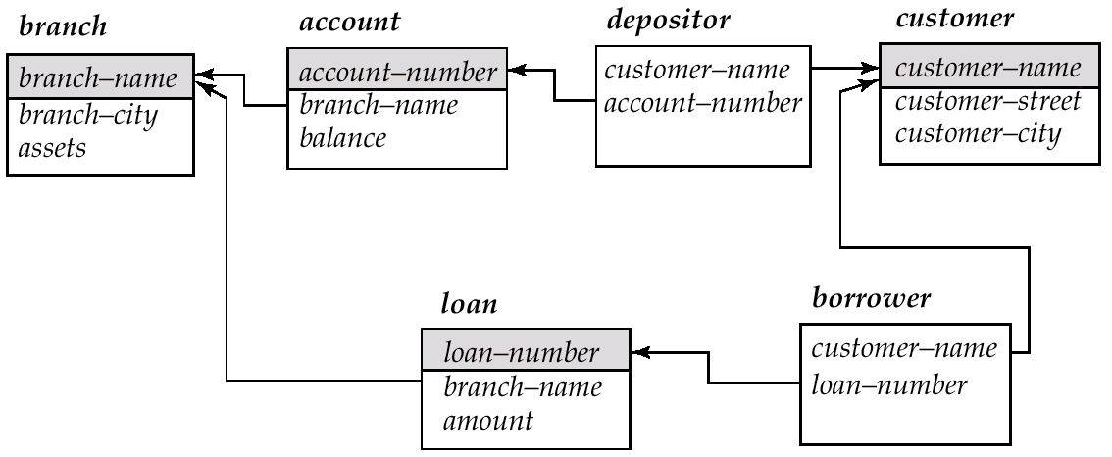
Schema Diagram for the Banking Enterprise

Slide 122
Examples
Married(person1_ssn, person2_ssn, date_married, date_divorced)
Account(cust_ssn, account_number, cust_name, balance, cust_address)
RA(student_id, project_id, superviser_id, appt_time, appt_start_date, appt_end_date)
Person(Name, DOB, Born, Education, Religion, …)
Information typically found on Wikipedia Pages

Slide 123
Examples
Married(person1_ssn, person2_ssn, date_married, date_divorced)
Account(cust_ssn, account_number, cust_name, balance, cust_address)
If a single account per customer, then: cust_ssn
Else: (cust_ssn, account_number)
In the latter case, this is not a good schema because it requires repeating information
RA(student_id, project_id, superviser_id, appt_time, appt_start_date, appt_end_date)
Could be smaller if there are some restrictions – requires some domain knowledge of the data being stored
Person(Name, DOB, Born, Education, Religion, …)
Information typically found on Wikipedia Pages
Unclear what could be a primary key here: you could in theory have two people who match on all of those

Slide 124
CMSC424: Database Design Module: Relation Model + SQL
SQL: Functions, Procedures, Recursive Queries, Triggers, Authorization, …
Instructor: Amol Deshpande
amol@cs.umd.edu

Slide 125
Miscellaneous SQL
Book Chapters (7th Edition)
Sections 4.7, 5.2, 5.3, 5.4, 5.5.1
Mostly at a high level
See Assignment 2
Key topics
Ranking over relations or results
Recursion in SQL (makes SQL Turing Complete)
Windows
Unnest and Lateral
Functions and Procedures
Triggers
Authorization

Slide 126
Ranking
ID | Salary | Rank
15151 | 95000 | 1
83821 | 92000 | 2
12121 | 90000 | 3
33456 | 87000 | 4
98345 | 80000 | 5
76543 | 80000 | 5
45565 | 75000 | 7
76766 | 72000 | 8
10101 | 65000 | 9
58583 | 62000 | 10
32343 | 60000 | 11
15151 | 40000 | 12
Goal: Rank tuples by some property
In DENSE_RANK, we would not skip 6 -- so the last
rank would be 11.
Notes:
¹²⁶

Slide 127
Ranking
Ranking is done in conjunction with an order by specification.
Basic SQL:
select ID, Salary, (1 + (select count(*) from Instructor B where B.Salary > A.Salary)) as s_rank from Instructor A order by s_rank;
Variation 1
select ID, Salary, ((select count(*) from Instructor B where B.Salary >= A.Salary)) as s_rank from Instructor A order by s_rank;
We would skip
5 instead of 6
i.e., after 4, the next rank
would be 6 (for two tuples)
Notes:
¹²⁷

Slide 128
Ranking
Ranking is done in conjunction with an order by specification.
Basic SQL:
select ID, Salary, (1 + (select count(*) from Instructor B where B.Salary > A.Salary)) as s_rank from Instructor A order by s_rank;
Variation 2
select ID, Salary, (1 + (select count(distinct Salary) from Instructor B where B.Salary > A.Salary)) as s_rank from Instructor A order by s_rank;
Equivalent to DENSE_RANK
We would not skip a rank
Two tuples with rank = 5
Next tuple with rank = 6
Notes:
¹²⁸

Slide 129
Ranking
Ranking is done in conjunction with an order by specification.
Basic SQL:
select ID, Salary, (1 + (select count(*) from Instructor B where B.Salary > A.Salary)) as s_rank from Instructor A order by s_rank;
Variation 3
select ID, Salary, (1 + (select count(Salary) from Instructor B where B.Salary < A.Salary)) as s_rank from Instructor A order by s_rank;
Opposite rank order
Tuple with lower salary has
rank = 1
Notes:
¹²⁹

Slide 130
Ranking
Ranking is done in conjunction with an order by specification.
Basic SQL:
select ID, Salary, (1 + (select count(*) from Instructor B where B.Salary > A.Salary)) as s_rank from Instructor A order by s_rank;
select ID, Salary, rank() over (order by salary desc) as s_rank from instructor order by s_rank
SQL Support
PostgreSQL support dense_rank()
as well
Notes:
¹³⁰

Slide 131
Ranking
Ranking is done in conjunction with an order by specification.
Basic SQL:
select ID, Salary, (1 + (select count(*) from Instructor B where B.Salary > A.Salary)) as s_rank from Instructor A order by s_rank;
select ID, Salary, rank() over (order by
(select count(*) from teaches where teaches.id = instructor.id)
desc) as s_rank from instructor order by s_rank
SQL Support -- can do subqueries and rank on results
Notes:
¹³¹

Slide 132
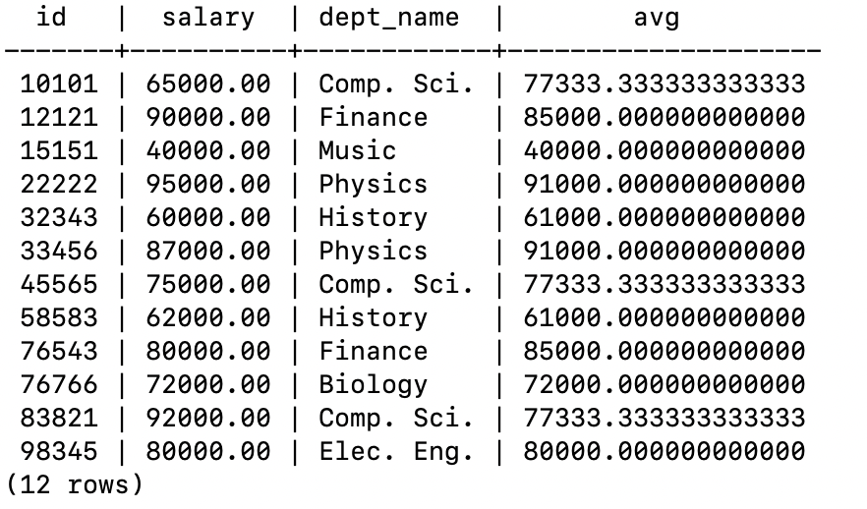
Window Functions
Similar to “Group By” – allows a calculation over “related” tuples
Unlike aggregates, does not “group” them – rather rows remain separate from each other
Goal: Associate each instructor row with average salary across all instructors
from that department

Slide 133
Window Functions
Similar to “Group By” – allows a calculation over “related” tuples
Unlike aggregates, does not “group” them – rather rows remain separate from each other
Goal: Associate each instructor row with average salary across all instructors
from that department
select ID, Salary, Dept_name, (select avg(salary) from Instructor B where B.dept_name = A. dept_name) from Instructor A;
Common enough task to simplify the syntax:
select ID, Salary, Dept_name, avg(salary) over (partition by dept_name) from Instructor;
Benefits: (1) Simpler syntax
(2) Easier to optimize

Slide 134
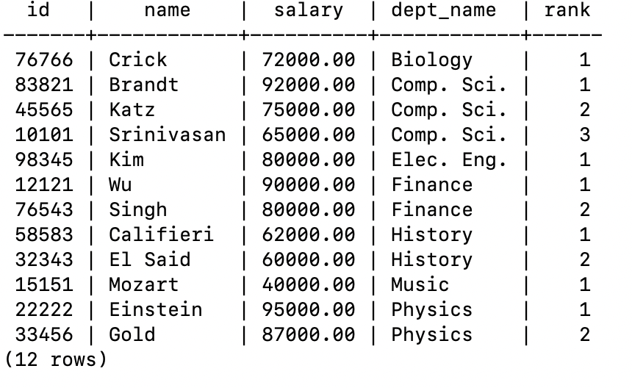
Window Functions
Similar to “Group By” – allows a calculation over “related” tuples
Unlike aggregates, does not “group” them – rather rows remain separate from each other
Goal: Associate each instructor row the “rank” for that instructor by salary
within that department
select ID, Salary, Dept_name, rank() over (partition by dept_name order by salary desc) from Instructor;

Slide 135
Recursion in SQL
Example: find which courses are a prerequisite, whether directly or indirectly, for a specific course
with recursive rec_prereq(course_id, prereq_id) as ( select course_id, prereq_id from prereq union select rec_prereq.course_id, prereq.prereq_id, from rec_rereq, prereq where rec_prereq.prereq_id = prereq.course_id ) select ∗ from rec_prereq;
Makes SQL Turing Complete (i.e., you can write any program in SQL)
But: Just because you can, doesn’t mean you should

Slide 136
Recursion in SQL
Example: find which courses are a prerequisite, whether directly or indirectly, for a specific course
Iteration 2: rec_prereq =
course_id | prereq_id
CMSC424 | CMSC351
CMSC424 | CMSC330
CMSC351 | CMSC250
CMSC250 | CMSC216
CMSC216 | CMSC132
CMSC132 | CMSC131
course_id | prereq_id
CMSC424 | CMSC351
CMSC424 | CMSC330
CMSC351 | CMSC250
CMSC250 | CMSC216
CMSC216 | CMSC132
CMSC132 | CMSC131
CMSC424 | CMSC250
CMSC351 | CMSC216
CMSC250 | CMSC132
CMSC216 | CMSC131
Iteration 1: rec_prereq =
course_id | prereq_id
CMSC424 | CMSC351
CMSC424 | CMSC330
CMSC351 | CMSC250
CMSC250 | CMSC216
CMSC216 | CMSC132
CMSC132 | CMSC131

Slide 137
Recursion in SQL
Example: find which courses are a prerequisite, whether directly or indirectly, for a specific course
Iteration 3: rec_prereq =
course_id | prereq_id
CMSC424 | CMSC351
CMSC424 | CMSC330
CMSC351 | CMSC250
CMSC250 | CMSC216
CMSC216 | CMSC132
CMSC132 | CMSC131
course_id | prereq_id
CMSC424 | CMSC351
CMSC424 | CMSC330
CMSC351 | CMSC250
CMSC250 | CMSC216
CMSC216 | CMSC132
CMSC132 | CMSC131
CMSC424 | CMSC250
CMSC351 | CMSC216
CMSC250 | CMSC132
CMSC216 | CMSC131
CMSC424 | CMSC216
CMSC424 | CMSC132
… | …
… | …
Iteration 1: rec_prereq =
course_id | prereq_id
CMSC424 | CMSC351
CMSC424 | CMSC330
CMSC351 | CMSC250
CMSC250 | CMSC216
CMSC216 | CMSC132
CMSC132 | CMSC131

Slide 138
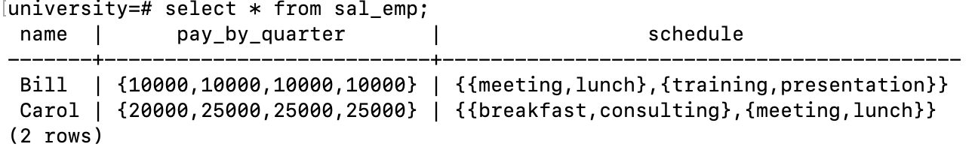
Arrays and Unnest
Allows taking an array attribute and separate out its elements
CREATE TABLE sal_emp
(name text,
pay_by_quarter integer[],
schedule text[][] );
INSERT INTO sal_emp VALUES ('Bill', '{10000, 10000, 10000, 10000}’,
'{{"meeting", "lunch"}, {"training", "presentation"}}’);
INSERT INTO sal_emp VALUES ('Carol', '{20000, 25000, 25000, 25000}’, '{{"breakfast", "consulting"}, {"meeting", "lunch"}}');
https://www.postgresql.org/docs/current/arrays.html

Slide 139
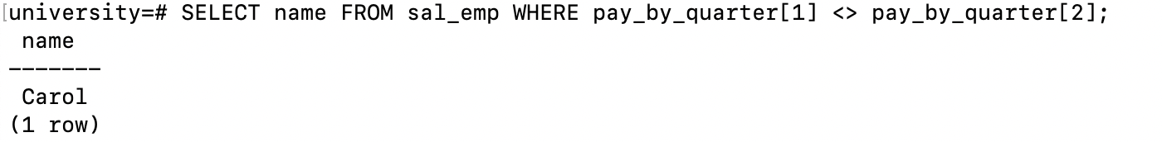
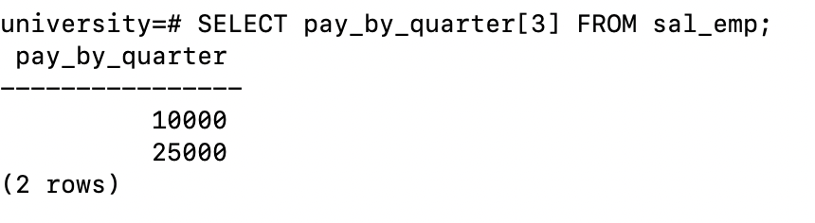
Arrays and Unnest
Allows taking an array attribute and separate out its elements
https://www.postgresql.org/docs/current/arrays.html

Slide 140
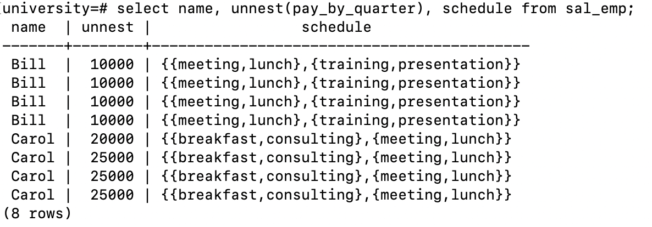
Arrays and Unnest
Allows taking an array attribute and separate out its elements
https://www.postgresql.org/docs/current/arrays.html

Slide 141
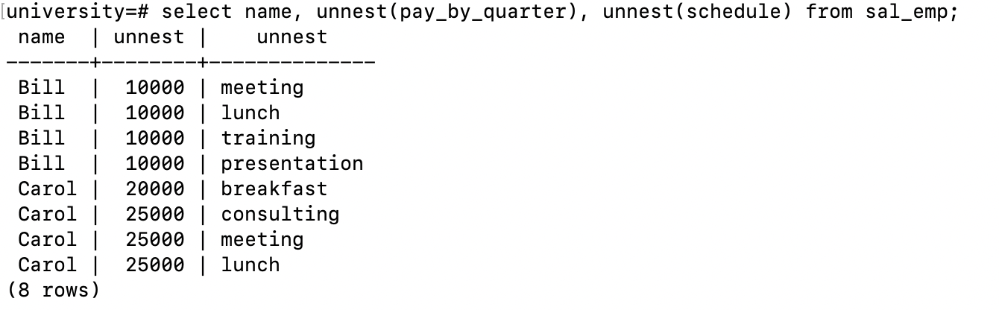
Arrays and Unnest
Allows taking an array attribute and separate out its elements
https://www.postgresql.org/docs/current/arrays.html

Slide 142
SQL Functions
Function to count number of instructors in a department
create function dept_count (dept_name varchar(20)) returns integer begin declare d_count integer; select count (* ) into d_count from instructor where instructor.dept_name = dept_name return d_count; end
Can use in queries
select dept_name, budget from department where dept_count (dept_name ) > 12

Slide 143
SQL Procedures
Same function as a procedure
create procedure dept_count_proc (in dept_name varchar(20), out d_count integer) begin
select count(*) into d_count from instructor where instructor.dept_name = dept_count_proc.dept_name
end
But use differently:
declare d_count integer; call dept_count_proc( ‘Physics’, d_count);
HOWEVER: Syntax can be wildly different across different systems
Was put in place by DBMS systems before standardization
Hard to change once customers are already using it

Slide 144
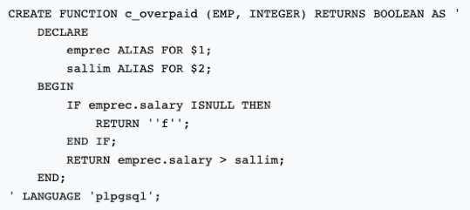
SQL Functions/Procedures
Stored procedures widely used in practice
Many benefits including reusability, better performance (reduce back and forth to the DB)
Most database systems support multiple langauges
Purely SQL → Fully procedural (e.g., C, etc)
PostgreSQL supports SQL, C, PL/pgSQL
Note PostgreSQL 10 (that we use) does not support PROCEDURE, only FUNCTION

Slide 145
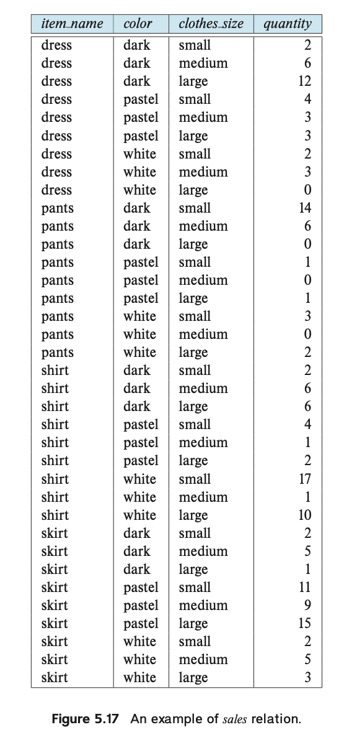
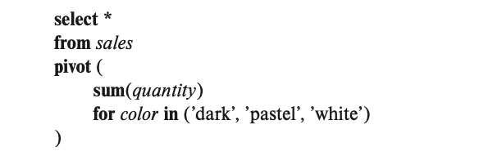
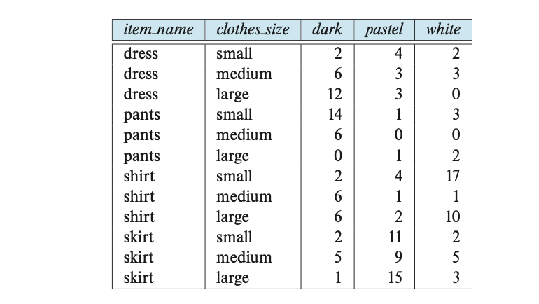
Pivots, Rollups, Cubes
Not supported by PostgreSQL as is
Has something called “crosstab”

Slide 146
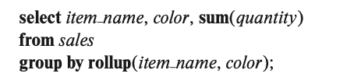
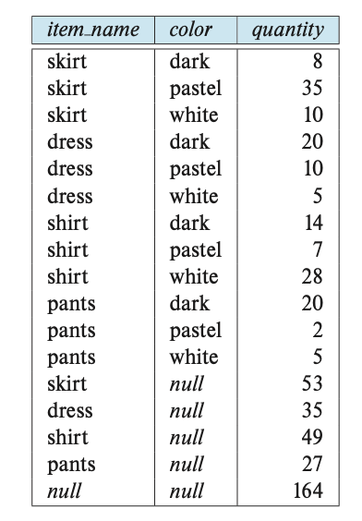
Pivots, Rollups, Cubes
Not supported by PostgreSQL as is
Has something called “crosstab”

Slide 147
Triggers
A trigger is a statement that is executed automatically by the system as a side effect of a modification to the database.
Suppose that instead of allowing negative account balances, the bank deals with overdrafts by
1. setting the account balance to zero
2. creating a loan in the amount of the overdraft
3. giving this loan a loan number identical to the account number of the overdrawn account
Notes:
To design a trigger mechanism, we must:
Specify the conditions under which the trigger is to be executed.
Specify the actions to be taken when the trigger executes.
Triggers introduced to SQL standard in SQL:1999, but supported even earlier using non-standard syntax by most databases.

Slide 148
Trigger Example in SQL:1999
create trigger overdraft-trigger after update on account referencing new row as nrow for each row when nrow.balance < 0 begin atomic actions to be taken
end

Slide 149
Trigger Example in SQL:1999
create trigger overdraft-trigger after update on account referencing new row as nrow for each row when nrow.balance < 0 begin atomic insert into borrower (select customer-name, account-number from depositor where nrow.account-number = depositor.account-number); insert into loan values (nrow.account-number, nrow.branch-name, nrow.balance); update account set balance = 0 where account.account-number = nrow.account-number end

Slide 150
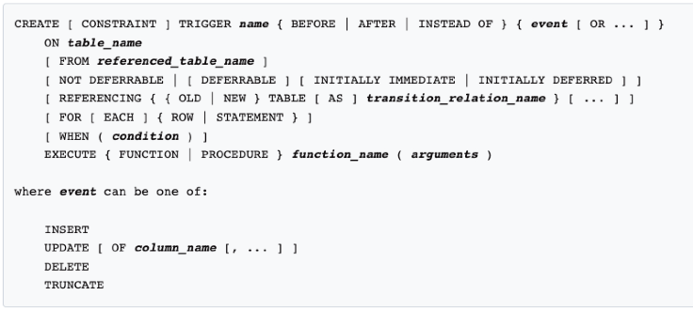
PostgreSQL Trigger Syntax
https://www.postgresql.org/docs/12/sql-createtrigger.html
NOTE: We use PostgreSQL 10, which does not support PROCEUDRE

Slide 151
Triggers…
External World Actions
How does the DB order something if the inventory is low ?
Syntax
Every system has its own syntax
Careful with triggers
Cascading triggers, Infinite Sequences…
More Info/Examples:
http://www.adp-gmbh.ch/ora/sql/create_trigger.html
Google: “create trigger” oracle download-uk
Notes:
Instead of executing a separate action for each affected row, a single action can be executed for all rows affected by a transaction
Use for each statement instead of for each row
Use referencing old table or referencing new table to refer to temporary tables (called transition tables) containing the affected rows
Can be more efficient when dealing with SQL statements that update a large number of rows
We sometimes require external world actions to be triggered on a database update
E.g. re-ordering an item whose quantity in a warehouse has become small, or turning on an alarm light,
Triggers cannot be used to directly implement external-world actions, BUT
Triggers can be used to record actions-to-be-taken in a separate table
Have an external process that repeatedly scans the table, carries out external-world actions and deletes action from table
E.g. Suppose a warehouse has the following tables
inventory(item, level): How much of each item is in the warehouse
minlevel(item, level) : What is the minimum desired level of each item
reorder(item, amount): What quantity should we re-order at a time
orders(item, amount) : Orders to be placed (read by external process)

Slide 152
Authorization/Security
GRANT and REVOKE keywords
grant select on instructor to U₁, U₂, U₃
revoke select on branch from U₁, U₂, U₃
Can provide select, insert, update, delete privileges
Can provide this for tables, schemas, “functions/procedures”, etc.
Some databases support doing this at the level of individual “tuples”
MS SQL Server: https://docs.microsoft.com/en-us/sql/relational-databases/security/row-level-security?view=sql-server-ver15
PostgreSQL: https://www.postgresql.org/docs/10/ddl-rowsecurity.html
Can also create “Roles” and do security at the level of roles
Notes:
¹⁵²

Slide 153
CMSC424: Database Design Aside
Anatomy of a Web Application
Instructor: Amol Deshpande
amol@umd.edu

Slide 154
Anatomy of a Web Application
Book Chapters (6th Edition)
Sections 9.1, 9.2, 9.3.5, 9.3.6, 9.4.3
Much not covered in depth in the book, but lot of good tutorials on the web
Key Topics
How Web Applications Work
Some of the underlying technologies
REST

Slide 155
Application Architecture Evolution
Three distinct eras of application architecture
Mainframe (1960’s and 70’s)
Personal computer era (1980’s)
Web era (mid 1990’s onwards)
Web and Smartphone era (2010 onwards)

Slide 156
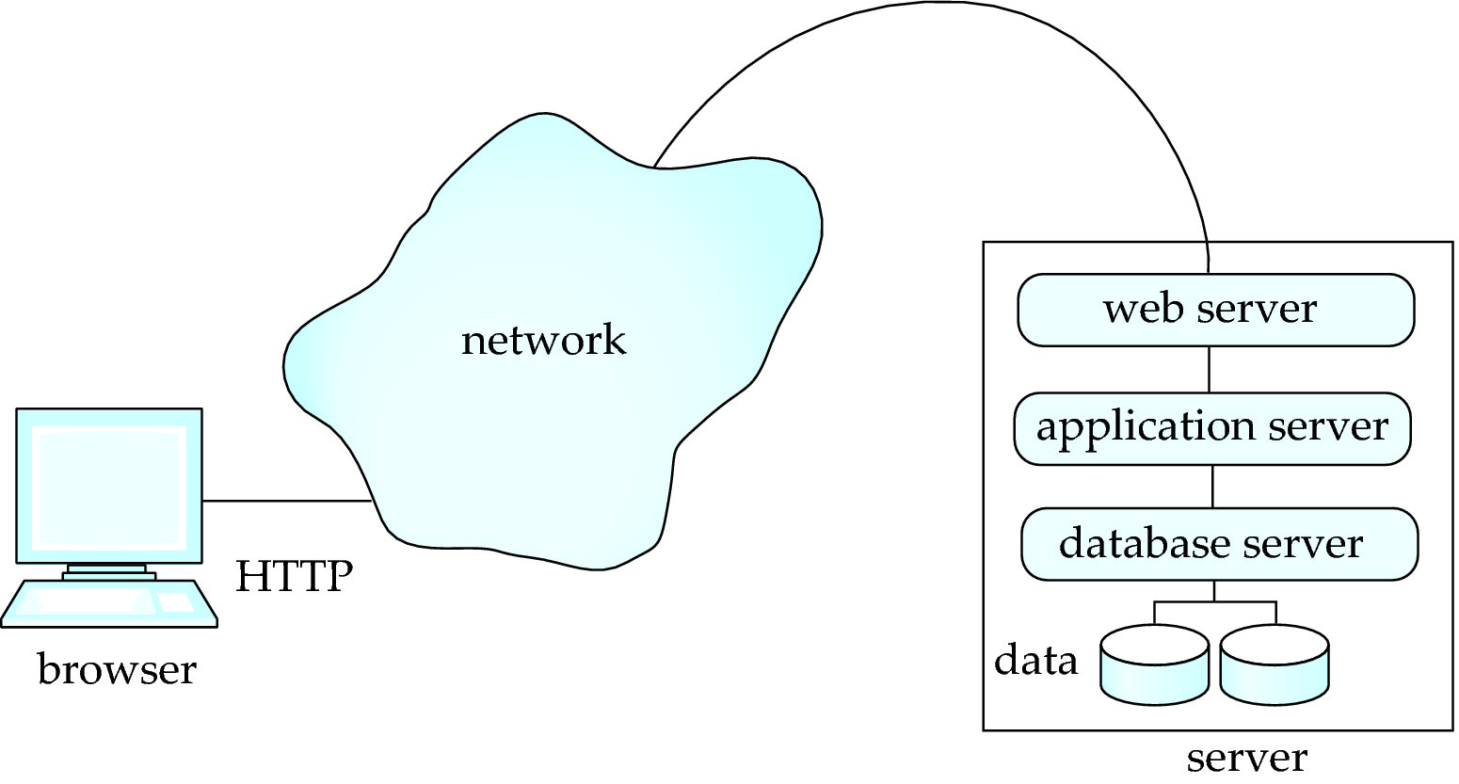
Web or Mobile Applications
Web browsers and mobile applications have become de facto standard user interface
Wide cross-platform accessibility
No need to download something
Three Tier or Two Tier Architectures

Slide 157
What runs where?
Flask, Django, Tomcat, Node.js, and others
Accept requests from the client and pass to the application server
Pass application server response back to the client
Support HTTP and HTTPS connections
Encapsulates business logic
Needs to support different user flows
Needs to handle all of the rendering and visualization
Ruby-on-rails, Django, Flask, Angular, React, PHP, and many others
Web Browser (Firefox, Chrome, Safari, Edge)
HTML to render webpages
Javascript for “client-side scripting” (running code in your browser without contacting the server)
Flash (not supported much – too much security risk)
Java “applets” – less common today
PostgreSQL, Oracle, SQL Server, Amazon RDS (Relational Databases)
MongoDB (Document/JSON databases)
SQLite --- not typically for production environments
Pretty much any database can be used…

Slide 158
Some Key Technologies
HTML
Controls display of content on webpages
HTTP/HTTPS, Sessions, Cookies
How “clients” connect to “servers”
Server-side vs client-side scripting
Some processing happens on the server, but increasingly on the client (though Javascript)
REST, SOAP, GraphQL
Protocols for “clients” to requests things from the “servers” (or for two web services to talk to each other)
Web APIs (typically REST or GraphQL)
Some services available on the Web

Slide 159
REST
Representation State Transfer: use standard HTTP requests to execute a request (against a web or application server) and return data
Technically REST is a software architectural style -- APIs that conform to it are called RESTful APIs
How REST uses the five standard HTTP request types:
POST: Invoke the method that corresponds to the URL, typically with data that is sent with the request
GET: Retrieve the data (no data sent with the request)
PUT: Reverse of GET
PATCH: Update some data
DELETE: Delete the data
Alternative: GraphQL -- uses HTTP POST calls, where the body of the call tells the web server what needs to be done
As someone on Stackoverflow put it: “REST is the way HTTP should be used."

Slide 160
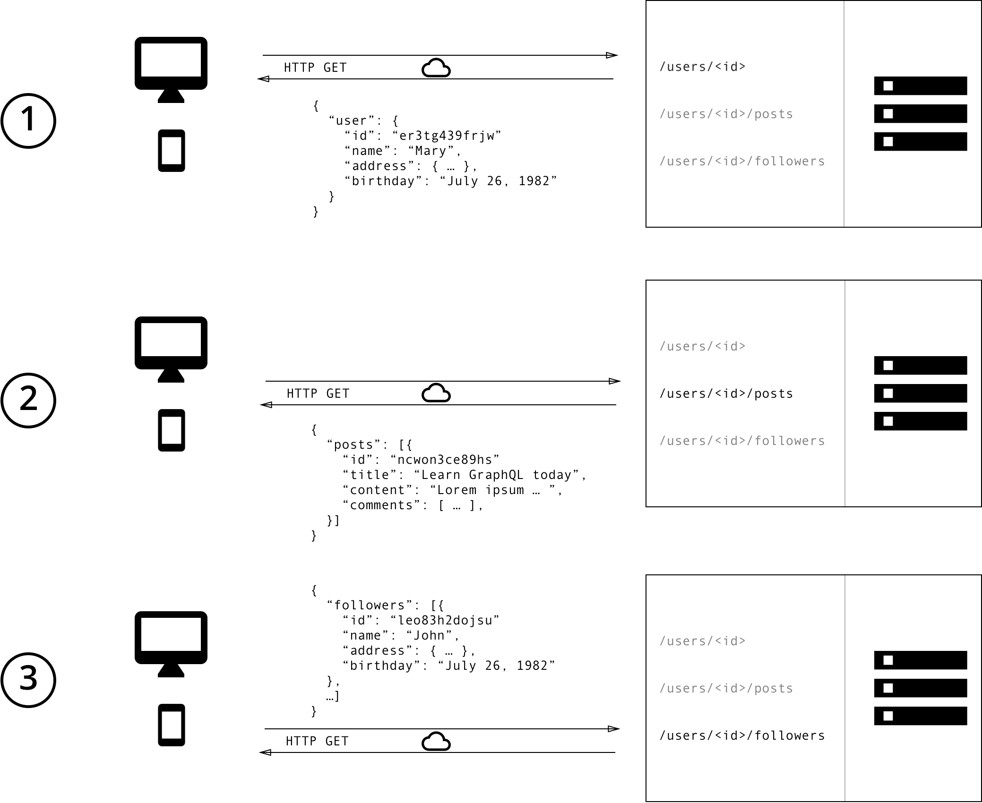
REST – GET Calls
https://www.howtographql.com/basics/1-graphql-is-the-better-rest/

Slide 161
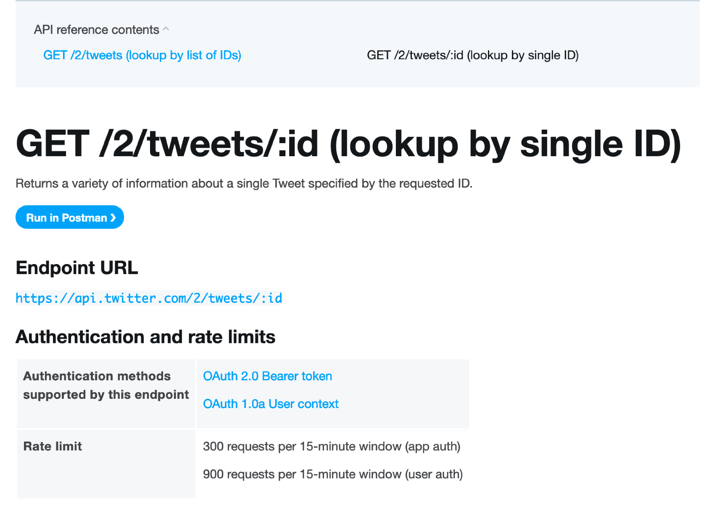
REST Example: Twitter

Slide 162
CMSC424: Database Design Module: Relational Model + SQL
SQL and Programming Languages
Instructor: Amol Deshpande
amol@umd.edu

Slide 163
SQL and Programming Languages
Book Chapters (6th Edition)
Sections 5.1, 9.4.2
Key Topics
Why use a programming language
Embedded SQL vs OBDC/JDBC
Object-relational impedance mismatch
Object-relational Mapping Frameworks

Slide 164
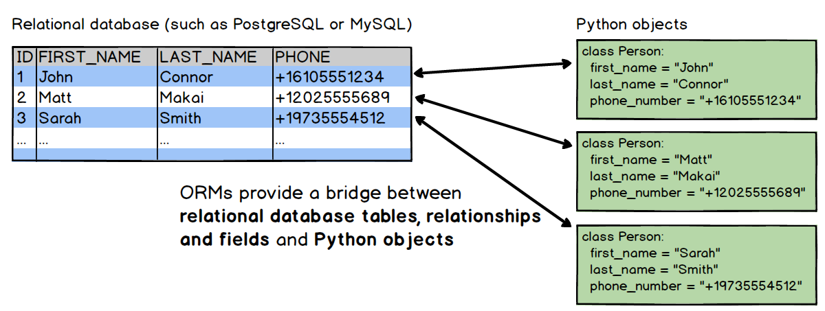
SQL and Programming Languages
Programmers/developers more comfortable using a programming language like Java, Python, etc.
SQL not natural for many things
Performance issues in going back and forth to the database
Need to deal with impedance mismatch between:
how data is represented in memory (typically as objects)
how it is stored (typically in a “normalized” relational schema)

Slide 165
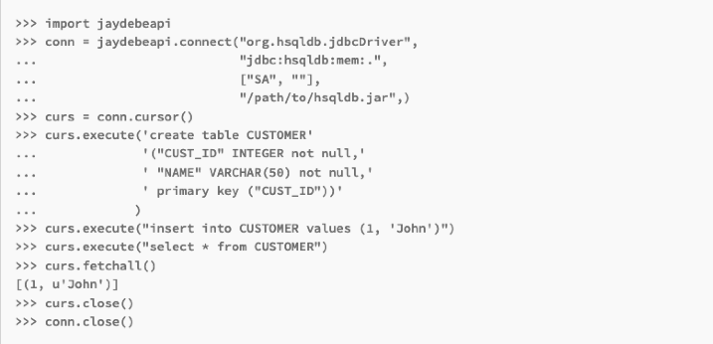
Option 1: JDBC/ODBC
Use a standard protocol like JDBC (Java Database Connectivity) to talk to the database from the programming language
Doesn’t solve impedance mismatch problem
Have to convert from the “result tuples” into “objects” and vice versa (when updating)

Slide 166
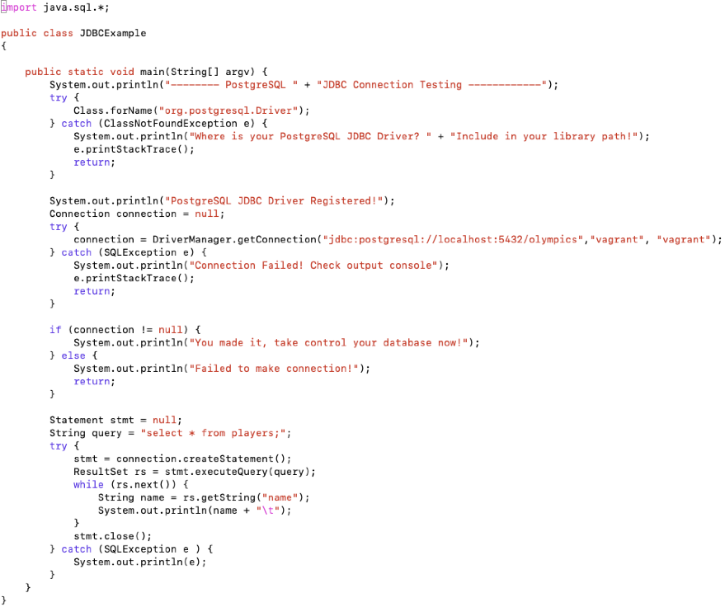

Slide 167
Option 1: JDBC/ODBC
WARNING: always use prepared statements when taking an input from the user and adding it to a query (Related to the issue of SQL Injection attacks)
NEVER create a query by concatenating strings
"insert into instructor values(' " + ID + " ', ' " + name + " ', " + " ' + dept name + " ', " ' balance + ')“
What if name is “D'Souza”?
PreparedStatement pStmt = conn.prepareStatement("insert into instructor values(?,?,?,?)"); pStmt.setString(1, "88877"); pStmt.setString(2, "Perry"); pStmt.setString(3, "Finance"); pStmt.setInt(4, 125000); pStmt.executeUpdate(); pStmt.setString(1, "88878"); pStmt.executeUpdate();
Python psycopg2 also has its own way of doing prepared statements
^{cur = conn.cursor()}
^{for i, j in parameters:}
cur.execute( "select * from tables where i = %s and j = %s", (i, j))
for record in cur: do_something_with(record)

Slide 168
Option 1: JDBC/ODBC
JDBC Features
Getting schemas, columns, primary keys
DatabaseMetaData dbmd = conn.getMetaData()
Transaction control
conn.commit(), conn.rollback()
Calling functions and procedures
ODBC: Open Database Connectivity Standard
Similar in many ways
Older – designed by Microsoft and typically used in C, C++, like languages
Java supports as well but slower

Slide 169
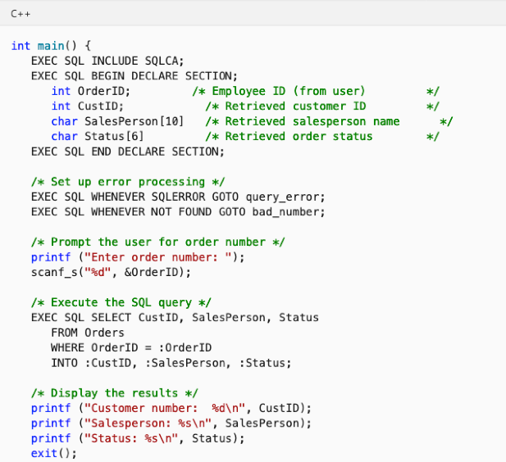
Option 2: Embedded SQL
SQL standard defines embeddings of SQL in a variety of programming languages such as C, C++, Java, Fortran, and PL/1
The language in which embedded is call “host” language

Slide 170
Option 2: Embedded SQL
SQL standard defines embeddings of SQL in a variety of programming languages such as C, C++, Java, Fortran, and PL/1
The language in which embedded is call “host” language
Needs compiler support for the host language
The compiler needs to know what to do with the EXEC SQL commands
Hard to port
Doesn’t solve impedance mismatch problem
Have to convert from the “result tuples” into “objects” and vice versa (when updating)
Not a preferred approach today

Slide 171
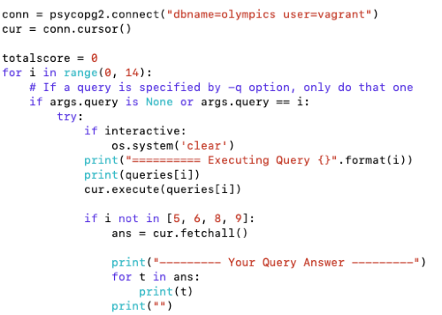
Option 3: Custom Libraries
Often there are vendor-specific libraries that sometimes use internal protocols (and not JDBC/ODBC)
e.g., python psycopg2 for PostgreSQL – although similar to JDBC calls, it uses the same proprietary protocol that ‘psql’ uses

Slide 172
Option 4: Object-relational Mappers
Aimed at solving the impedance mismatch
Primarily for Web Application Development
The ORM takes care of the mapping between objects and the database
Although largely designed around RDBMS, some ORMs support other databases as well
The programmer works with objects, and never directly sees the SQL
Has pros (easier to use) and cons (performance and correctness issues)
ORMs typically work with “Entities/Objects” and “Relationships”
Aligns well with the ER model that we will discuss next
We will cover Django constructs in more detail

Slide 173
Option 5: Other Mappers
Many other “wrappers” on top of relational databases that offer different functionalities
In some cases, operations written in a higher-level language mapped to SQL
like what we saw for ORMs
Microsoft LINQ is also similar
Allows intermixing of code mapped to SQL and other code
In some cases, used to provide alternate data models to users
e.g., a thin layer that provides a graph data model, but stores data in a relational database
Most “RDF” databases built on top of SQL databases
In today’s big data ecosystem, we see many many permutations how different tools (including databases) are combined together

Slide 174
CMSC424: Database Design Module: Relation Model + SQL
SQL: Integrity Constraints
Instructor: Amol Deshpande
amol@umd.edu

Slide 175
SQL Integrity Constraints
Book Chapters (6th Edition)
4.4
Key Topics
Why Constraints
Different Types of Integrity Constraints
Referential Integrity
How to specify in SQL

Slide 176
IC’s
Goal: Avoid Semantic Inconsistencies in the Data
An IC is a predicate on the database
Must always be true (checked whenever DB gets updated)
There are the following 4 types of IC’s:
Key constraints (1 table)
e.g., 2 accts can’t share the same acct_no
Attribute constraints (1 table)
e.g., accts must have nonnegative balance
Referential Integrity constraints ( 2 tables)
E.g. bnames associated w/ loans must be names of real branches
Global Constraints (n tables)
E.g., all loans must be carried by at least 1 customer with a savings acct

Slide 177
Key Constraints
Idea: specifies that a relation is a set, not a bag
SQL examples:
1. Primary Key:
CREATE TABLE branch(
bname CHAR(15) PRIMARY KEY,
bcity CHAR(20),
assets INT);
or
CREATE TABLE depositor(
cname CHAR(15),
acct_no CHAR(5),
PRIMARY KEY(cname, acct_no));
2. Candidate Keys:
CREATE TABLE customer (
ssn CHAR(9) PRIMARY KEY,
cname CHAR(15),
address CHAR(30),
city CHAR(10),
UNIQUE (cname, address, city));

Slide 178
Key Constraints
Effect of SQL Key declarations
PRIMARY (A1, A2, .., An) or
UNIQUE (A1, A2, ..., An)
Insertions: check if any tuple has same values for A1, A2, .., An as any
inserted tuple. If found, reject insertion
Updates to any of A1, A2, ..., An: treat as insertion of entire tuple
Primary vs Unique (candidate)
1 primary key per table, several unique keys allowed.
Only primary key can be referenced by “foreign key” (ref integrity)
DBMS may treat primary key differently
(e.g.: create an index on PK)

Slide 179
Attribute Constraints
Idea:
Attach constraints to values of attributes
Enhances types system (e.g.: >= 0 rather than integer)
In SQL:
1. NOT NULL
e.g.: CREATE TABLE branch(
bname CHAR(15) NOT NULL,
....
)
Note: declaring bname as primary key also prevents null values
2. CHECK
e.g.: CREATE TABLE depositor(
....
balance int NOT NULL,
CHECK( balance >= 0),
....
)
affect insertions, update in affected columns

Slide 180
Attribute Constraints
Domains: can associate constraints with DOMAINS rather than attributes
e.g: instead of: CREATE TABLE depositor(
....
balance INT NOT NULL,
CHECK (balance >= 0)
)
One can write:
CREATE DOMAIN bank-balance INT (
CONSTRAINT not-overdrawn CHECK (value >= 0),
CONSTRAINT not-null-value CHECK( value NOT NULL));
CREATE TABLE depositor (
.....
balance bank-balance,
)
Advantages?

Slide 181
Attribute Constraints
Advantage of associating constraints with domains:
1. can avoid repeating specification of same constraint
for multiple columns
2. can name constraints
e.g.: CREATE DOMAIN bank-balance INT (
CONSTRAINT not-overdrawn
CHECK (value >= 0),
CONSTRAINT not-null-value
CHECK( value NOT NULL));
allows one to:
1. add or remove:
ALTER DOMAIN bank-balance
ADD CONSTRAINT capped
CHECK( value <= 10000)
2. report better errors (know which constraint violated)

Slide 182
Referential Integrity Constraints
Idea: prevent “dangling tuples” (e.g.: a loan with a bname, Kenmore, when no Kenmore tuple in branch)
Referencing
Relation
(e.g. loan)
Referenced
Relation
(e.g. branch)
“foreign key”
bname
primary key
bname
Ref Integrity:
ensure that:
foreign key value → primary key value
(note: don’t need to ensure ←, i.e., not all branches have to have loans)

Slide 183
Referential Integrity Constraints
bname
bname
Referencing
Relation
(e.g. loan)
x
Referenced
Relation
(e.g. branch)
x
x
In SQL:
CREATE TABLE branch(
bname CHAR(15) PRIMARY KEY
....)
CREATE TABLE loan (
.........
FOREIGN KEY bname REFERENCES branch);
Affects:
1) Insertions, updates of referencing relation
2) Deletions, updates of referenced relation

Slide 184
Referential Integrity Constraints
c
c
t_{i}
x
t_{j}
x
x
what happens when
we try to delete
this tuple?
A
B
Ans: 3 possibilities
1) reject deletion/ update
2) set t_{i} [c], t_{j}[c] = NULL
3) propagate deletion/update
DELETE: delete ti, tj
UPDATE: set ti[c], tj[c] to updated values

Slide 185
Referential Integrity Constraints
c
c
t_{i}
x
t_{j}
x
x
what happens when
we try to delete
this tuple?
A
B
CREATE TABLE A ( .....
FOREIGN KEY c REFERENCES B action
.......... )
Action: 1) left blank (deletion/update rejected)
2) ON DELETE SET NULL/ ON UPDATE SET NULL
sets ti[c] = NULL, tj[c] = NULL
3) ON DELETE CASCADE
deletes ti, tj
ON UPDATE CASCADE
sets ti[c], tj[c] to new key values
Notes:
Use board to give the interesting example.
Also talk about transactions, and delayed constraint checking.
How about we set the manager to the manager of that guy ? Well that requires triggers.

Slide 186
Global Constraints
Idea: two kinds
1) single relation (constraints spans multiple columns)
E.g.: CHECK (total = svngs + check) declared in the CREATE TABLE
2) multiple relations: CREATE ASSERTION
SQL examples:
1) single relation: All Bkln branches must have assets > 5M
CREATE TABLE branch (
..........
bcity CHAR(15),
assets INT,
CHECK (NOT(bcity = ‘Bkln’) OR assets > 5M))
Affects:
insertions into branch
updates of bcity or assets in branch

Slide 187
Global Constraints
SQL example:
2) Multiple relations: every loan has a borrower with a savings account
CHECK (NOT EXISTS (
SELECT *
FROM loan AS L
WHERE NOT EXISTS(
SELECT *
FROM borrower B, depositor D, account A
WHERE B.cname = D.cname AND
D.acct_no = A.acct_no AND
L.lno = B.lno)))
Problem: Where to put this constraint? At depositor? Loan? ....
Ans: None of the above:
CREATE ASSERTION loan-constraint
CHECK( ..... )
Checked with EVERY DB update!
very expensive.....

Slide 188
Summary: Integrity Constraints
Constraint Type | Where declared | Affects... | Expense
Key Constraints | CREATE TABLE (PRIMARY KEY, UNIQUE) | Insertions, Updates | Moderate
Attribute Constraints | CREATE TABLE CREATE DOMAIN (Not NULL, CHECK) | Insertions, Updates | Cheap
Referential Integrity | Table Tag (FOREIGN KEY .... REFERENCES ....) | 1.Insertions into referencing rel’n 2. Updates of referencing rel’n of relevant attrs 3. Deletions from referenced rel’n 4. Update of referenced rel’n | 1,2: like key constraints. Another reason to index/sort on the primary keys 3,4: depends on a. update/delete policy chosen b. existence of indexes on foreign key
Global Constraints | Table Tag (CHECK) or outside table (CREATE ASSERTION) | 1. For single rel’n constraint, with insertion, deletion of relevant attrs 2. For assesrtions w/ every db modification | 1. cheap 2. very expensive

Slide 189
CMSC424: Database Design Module: Relational Model + SQL
SQL: Views
Instructor: Amol Deshpande
amol@umd.edu

Slide 190
SQL Views
Book Chapters (6th Edition)
3.8
Key Topics
Defining Views and Use Cases
Difference between a view and a table
Updating a view

Slide 191
Views
Provide a mechanism to hide certain data from the view of certain users. To create a view we use the command:
Can be used in any place a normal table can be used
For users, there is no distinction in terms of using it
create view v as <query expression>
where:
<query expression> is any legal expression
The view name is represented by v

Slide 192
Example Queries
A view consisting of courses and sections for Physics in Fall 2009
Find all physics fall 2009 courses in a building.

Slide 193
Views
Is it different from DBMS’s side ?
Yes; a view may or may not be materialized
Pros/Cons ?
Updates into views have to be treated differently
In most cases, disallowed.

Slide 194
Views vs Tables
Creating
Create view V
as (select *
from A, B
where …)
Create table T
as (select *
from A, B
where …)
Can be used
In any select query.
Only some update queries.
It’s a new table.
You can do what you want.
Maintained as
1. Evaluate the query and store it on disk as if a table.
2. Don’t store. Substitute in queries when referenced.
It’s a new table.
Stored on disk.
What if a tuple inserted in A ?
1. If stored on disk, the stored table is automatically updated to be accurate.
2. If we are just substituting, there is no need to do anything.
T is a separate table; there is no reason why DBMS should keep it updated. If you want that, you must define a trigger.

Slide 195
Views vs Tables
Views strictly supercede “create a table and define a trigger to keep it updated”
Two main reasons for using them:
Security/authorization
Can provide a user with ”read” access to only the view
Ease of writing queries
E.g. PresidentStateReturns , or a view listing who won which state
Perhaps the only reason to create a table is to force the DBMS to choose the option of “materializing”
That has efficiency advantages in some cases
Especially if the underlying tables don’t change

Slide 196
Update of a View
Create a view of all instructors while hiding the salary
Add a new tuple to the view
insert into faculty values (’30765’, ’Green’, ’Music’);
Options:
Reject because we don’t “salary” information, or
Insert into “instructors”: (’30765’, ’Green’, ’Music’, NULL);
Updates on more complex views are difficult or impossible to translate, and hence are disallowed.
Many SQL implementations allow updates only on simple views (without aggregates) defined on a single relation

Slide 197
CMSC424: Database Design Module: Relational Model + SQL
Transactions: Overview
Instructor: Amol Deshpande
amol@umd.edu

Slide 198
Transactions: Overview
Book Chapters (7th Edition)
4.3, 17
Key topics:
Transactions and ACID Properties
Different states a transaction goes through
Transactions in PostgreSQL

Slide 199
Transactions
A transaction is a sequence of queries and update statements executed as a single unit
Transactions are started implicitly and terminated by one of
commit work: makes all updates of the transaction permanent in the database
rollback work: undoes all updates performed by the transaction.
Motivating example
Transfer of money from one account to another involves two steps:
deduct from one account and credit to another
If one steps succeeds and the other fails, database is in an inconsistent state
Therefore, either both steps should succeed or neither should
If any step of a transaction fails, all work done by the transaction can be undone by rollback work.
Rollback of incomplete transactions is done automatically, in case of system failures

Slide 200
Transactions (Cont.)
In most database systems, each SQL statement that executes successfully is automatically committed.
Each transaction would then consist of only a single statement
Automatic commit can usually be turned off, allowing multi-statement transactions, but how to do so depends on the database system
Another option in SQL:1999: enclose statements within begin atomic … end

Slide 201
Examples of Transactions
insert into students values (…)
update instructor
set salary = salary * 1.03
enrolled = select count(*)
from takes
where (course_info) = (CMSC 424, 201, Fall 2022)
if enrolled < capacity for the room:
insert new student into takes for that course
(Modify prerequisites)
delete (CMSC422, CMSC351)
insert (CMSC422, CMSC320)
(Add a new section for a course for a given room and instructor)
if no section currently in that room:
insert a tuple into “sections” with that room
insert a tuple into “teaches”
(Remove a section)
delete from takes for that section
delete from teaches for that section
delete tuple from section
(Switch the advisor for a student)
delete old tuple with that s_id
add new tuple with that s_id and new advisor

Slide 202
Examples of Transactions
update instructor
set salary = salary * 1.03
What if only part of the transaction
was completed?
(Modify prerequisites)
delete (CMSC422, CMSC351)
insert (CMSC422, CMSC320)
(Remove a section)
delete from takes for that section
delete from teaches for that section
delete tuple from section
(Switch the advisor for a student)
delete old tuple with that s_id
add new tuple with that s_id and new advisor

Slide 203
Examples of Transactions
enrolled = select count(*)
from takes
where (course_info) = (CMSC 424, 201, Fall 2022)
if enrolled < capacity for the room:
insert student A into takes for that course
enrolled = select count(*)
from takes
where (course_info) = (CMSC 424, 201, Fall 2022)
if enrolled < capacity for the room:
insert student B into takes for that course
What if two different students tried to enroll at the same time?

Slide 204
Overview
Transaction: A sequence of database actions enclosed within special tags
Properties:
Atomicity: Entire transaction or nothing
Consistency: Transaction, executed completely, takes database from one consistent state to another
Isolation: Concurrent transactions appear to run in isolation
Durability: Effects of committed transactions are not lost
Consistency: Transaction programmer needs to guarantee that
DBMS can do a few things, e.g., enforce constraints on the data
Rest: DBMS guarantees

Slide 205
How does..
.. this relate to queries that we discussed ?
Queries don’t update data, so durability and consistency not relevant
Would want concurrency
Consider a query computing total balance at the end of the day
Would want isolation
What if somebody makes a transfer while we are computing the balance
Typically not guaranteed for such long-running queries
TPC-C vs TPC-H

Slide 206
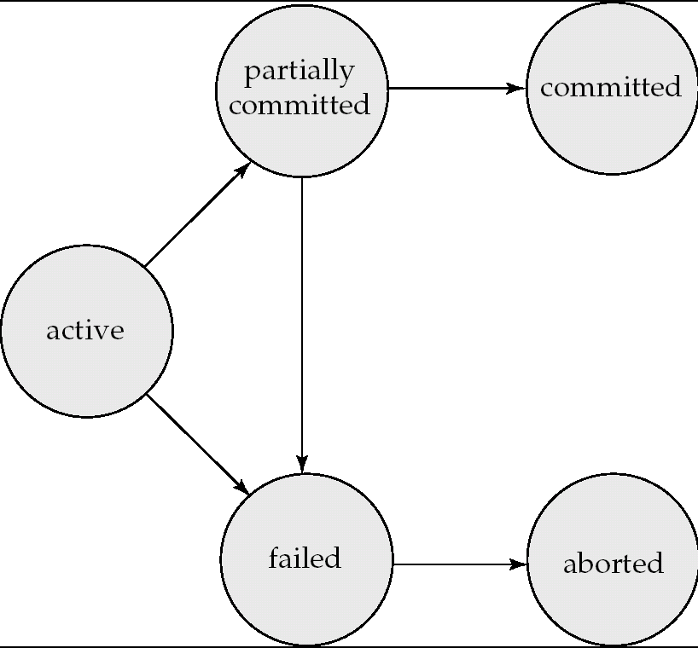
Transaction states
Successful Completion
Initial State – stays in this during execution
Any changes have been rolled back

Slide 207
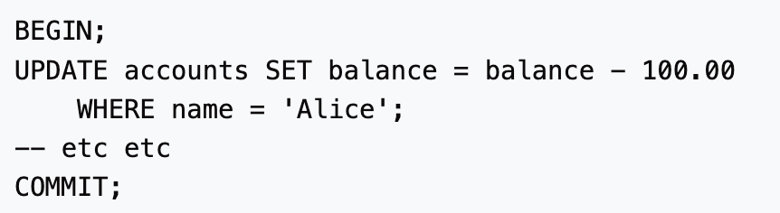
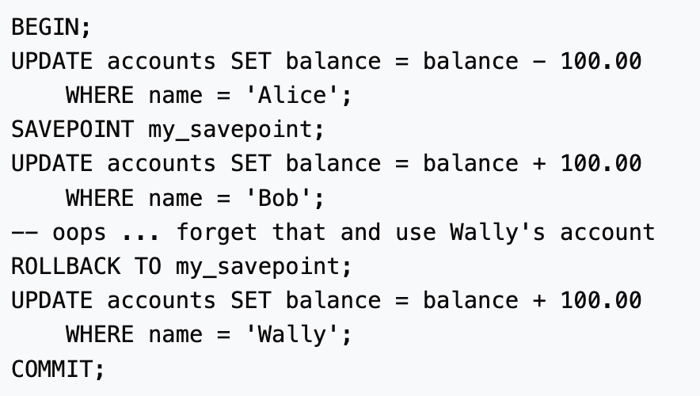
Transactions in PostgreSQL
PostgreSQL actually treats every SQL statement as being executed within a transaction. If you do not issue a BEGIN command, then each individual statement has an implicit BEGIN and (if successful) COMMIT wrapped around it. A group of statements surrounded by BEGIN and COMMIT is sometimes called a transaction block.
https://www.postgresql.org/docs/current/tutorial-transactions.html

Slide 208
Summary
Transactions is how we update data in databases
ACID properties: foundations on which high-performance transaction processing systems are built
From the beginning, consistency has been a key requirement
Although “relaxed” consistency is acceptable in many cases (originally laid out in 1975)
NoSQL systems originally eschewed ACID properties
MongoDB was famously bad at guaranteeing any of the properties
Lot of focus on what’s called “eventual consistency”
Recognition today that strict ACID is more important than that
Hard to build any business logic if you have no idea if your transactions are consistent

Slide 209
CMSC424: Database Design Module: Relational Model + SQL
Transactions: Isolation
Instructor: Amol Deshpande
amol@umd.edu

Slide 210
Isolation and Concurrency Levels
Book Chapters
14.5
Key topics:
Why Concurrency
Notion of a ”Schedule”
Serializability
Isolation Levels

Slide 211
A Schedule
Transactions:
T1: transfers $50 from A to B
T2: transfers 10% of A to B
Database constraint: A + B is constant (checking+saving accts)
T1
read(A)
A = A -50
write(A)
read(B)
B=B+50
write(B)
T2
read(A)
tmp = A*0.1
A = A – tmp
write(A)
read(B)
B = B+ tmp
write(B)
Effect: Before After
A 100 45
B 50 105
Each transaction obeys the constraint.
This schedule does too.

Slide 212
Schedules
A schedule is simply a (possibly interleaved) execution sequence of transaction instructions
Serial Schedule: A schedule in which transaction appear one after the other
ie., No interleaving
Serial schedules satisfy isolation and consistency
Since each transaction by itself does not introduce inconsistency

Slide 213
Example Schedule
Another “serial” schedule:
T1
read(A)
A = A -50
write(A)
read(B)
B=B+50
write(B)
T2
read(A)
tmp = A*0.1
A = A – tmp
write(A)
read(B)
B = B+ tmp
write(B)
Effect: Before After
A 100 40
B 50 110
Consistent ?
Constraint is satisfied.
Since each Xion is consistent, any
serial schedule must be consistent

Slide 214
Another schedule
T1
read(A)
A = A -50
write(A)
read(B)
B=B+50
write(B)
T2
read(A)
tmp = A*0.1
A = A – tmp
write(A)
read(B)
B = B + tmp
write(B)
Is this schedule okay ?
Lets look at the final effect…
Effect: Before After
A 100 45
B 50 105
Consistent.
So this schedule is okay too.

Slide 215
Another schedule
T1
read(A)
A = A -50
write(A)
read(B)
B=B+50
write(B)
T2
read(A)
tmp = A*0.1
A = A – tmp
write(A)
read(B)
B = B+ tmp
write(B)
Is this schedule okay ?
Lets look at the final effect…
Effect: Before After
A 100 45
B 50 105
Further, the effect same as the
serial schedule 1.
Called serializable

Slide 216
Example Schedules (Cont.)
A “bad” schedule
T1
read(A)
A = A -50
write(A)
read(B)
B=B+50
write(B)
T2
read(A)
tmp = A*0.1
A = A – tmp
write(A)
read(B)
B = B+ tmp
write(B)
Effect: Before After
A 100 50
B 50 60
Not consistent

Slide 217
Desired Property 1: Serializability
A schedule is called serializable if its final effect is the same as that of a serial schedule
Serializability → schedule is fine and doesn’t cause inconsistencies
Since serial schedules are fine
Non-serializable schedules unlikely to result in consistent databases
Not possible to look at all n! serial schedules to check if the effect is the same
Instead we ensure serializability by allowing or not allowing certain schedules

Slide 218
Desired Property 1: Serializability
However, serializability is considered too expensive to enforce
SQL Standard allows “relaxed” consistency levels
Defined in terms of three desirable properties (or in terms of “anomalies” to avoid)
No phantom phenomenon
Repeatable read
No dirty reads

Slide 219
Desired Property 2: No Phantom Phenomenon
Schema: accounts(acct_no, balance, zipcode, …)
Transaction 1: Find the number of accounts in zipcode = 20742, and divide $1,000,000 between them
Transaction 2: Insert <acctX, …, 20742, …>
1. Transaction 1 counts the number of accounts with zipcode = 20742 (say 100)
2. Transaction 1 computes:
share = 1000000/count
= 10,000
3. Transaction 2 inserts a new account with the same zipcode
4. Transaction 1 goes through and adds “10,000” to every account with zipcode = 20742
Including the new account
So the total amount was higher

Slide 220
Desired Property 3: Repeatable Read
Schema: accounts(acct_no, balance, zipcode, …)
Transaction 1: Reads account #10549 twice
Transaction 2: Updates account #10549
1. Transaction 1 reads account #10549 information to show user the balance
2. Transaction 2 updates account #10549
3. Transaction 1 reads/write account #10549 information based on user action
Transaction 1 reads a different value the second time
(Note: Transaction 1 could “remember” it -- this is assuming that it doesn’t

Slide 221
Desired Property 4: No Dirty Read
Schema: accounts(acct_no, balance, zipcode, …)
Transaction 1: Reads info for #10549
Transaction 2: Updates several accounts over a period of time
Transaction 2 starts
Transaction 2 updates #10549
3. Transaction 1 reads info for #10549
4. Transaction 2 updates #10342
5. Transaction 2 finishes
Transaction 1 read “uncommitted” (“dirty”) data
What if Transaction 2 never finishes, and is rolled back?

Slide 222
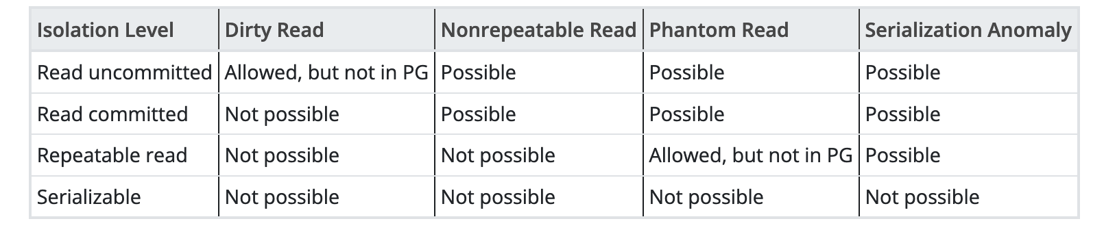
Weak Levels of Consistency in SQL
SQL allows non-serializable executions
Unfortunately slightly different interpretations of the different properties
In PostgreSQL, can set the level per transaction
https://www.postgresql.org/docs/current/transaction-iso.html

Slide 223
Weak Levels of Consistency in SQL
In many database systems, read committed is default
has to be explicitly changed to serializable when required
set isolation level serializable
MySQL InnoDB defaults to repeatable read
Oracle has no repeatable read
But does support a “read_only” mode
Let’s the transaction see all data as of the time it started
Part of what’s called “snapshot isolation”
IBM DB2
Repeatable read is actually “serializable”
Has a different mode called “read stability” -- equivalent to “repeatable read”

Slide 224
CMSC424: Database Design NOT IN SYLLABUS
SQLMan: Wielding the Superpower of SQL
Instructor: Amol Deshpande
amol@umd.edu

Slide 225
Fun with SQL
https://blog.jooq.org/2016/04/25/10-sql-tricks-that-you-didnt-think-were-possible/
Long slide-deck linked off of this page
Complex SQL queries showing how to do things like: do Mandelbrot, solve subset sum problem etc.
The MADlib Analytics Library or MAD Skills, the SQL; https://arxiv.org/abs/1208.4165
https://www.red-gate.com/simple-talk/blogs/statistics-sql-simple-linear-regressions/

Slide 226
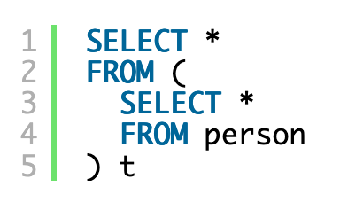
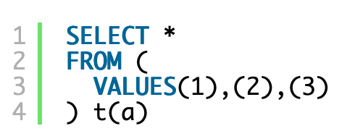
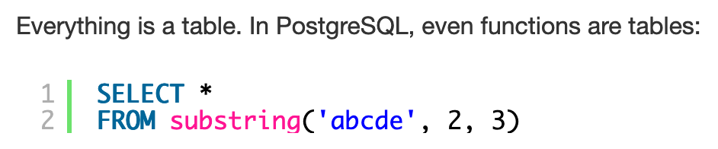
1. Everything is a Table
https://blog.jooq.org/2016/04/25/10-sql-tricks-that-you-didnt-think-were-possible/

Slide 227
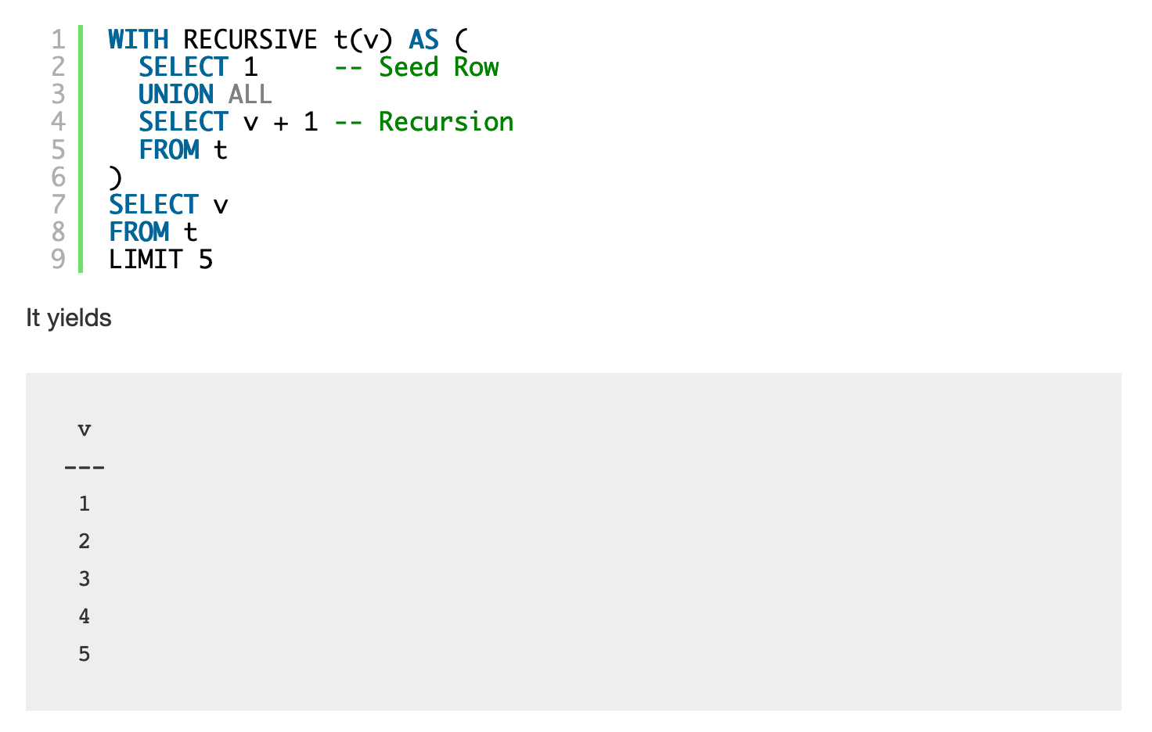
2. Recursion can be very powerful
Makes SQL Turing-Complete
https://blog.jooq.org/2016/04/25/10-sql-tricks-that-you-didnt-think-were-possible/

Slide 228
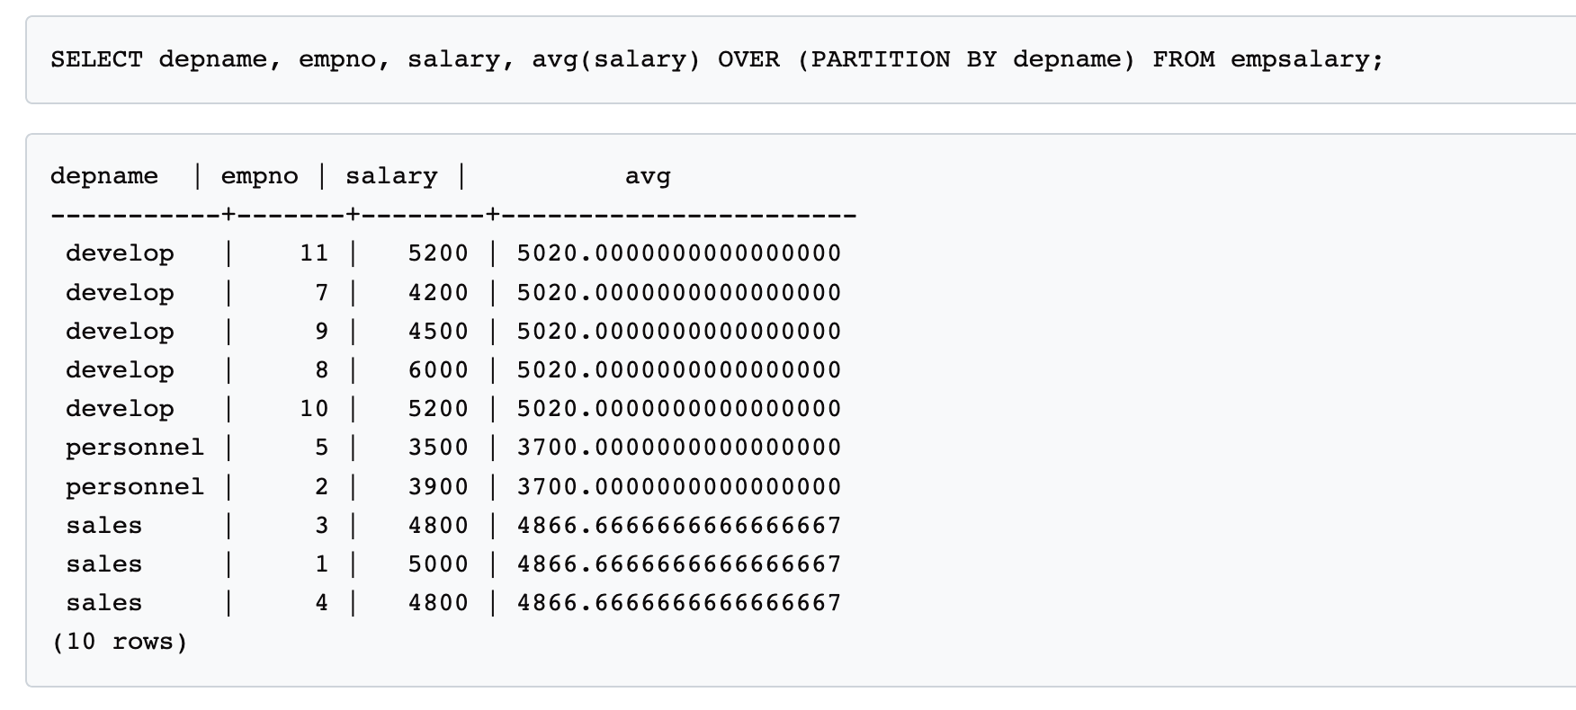
3. Window Functions
https://www.postgresql.org/docs/9.3/tutorial-window.html

Slide 229
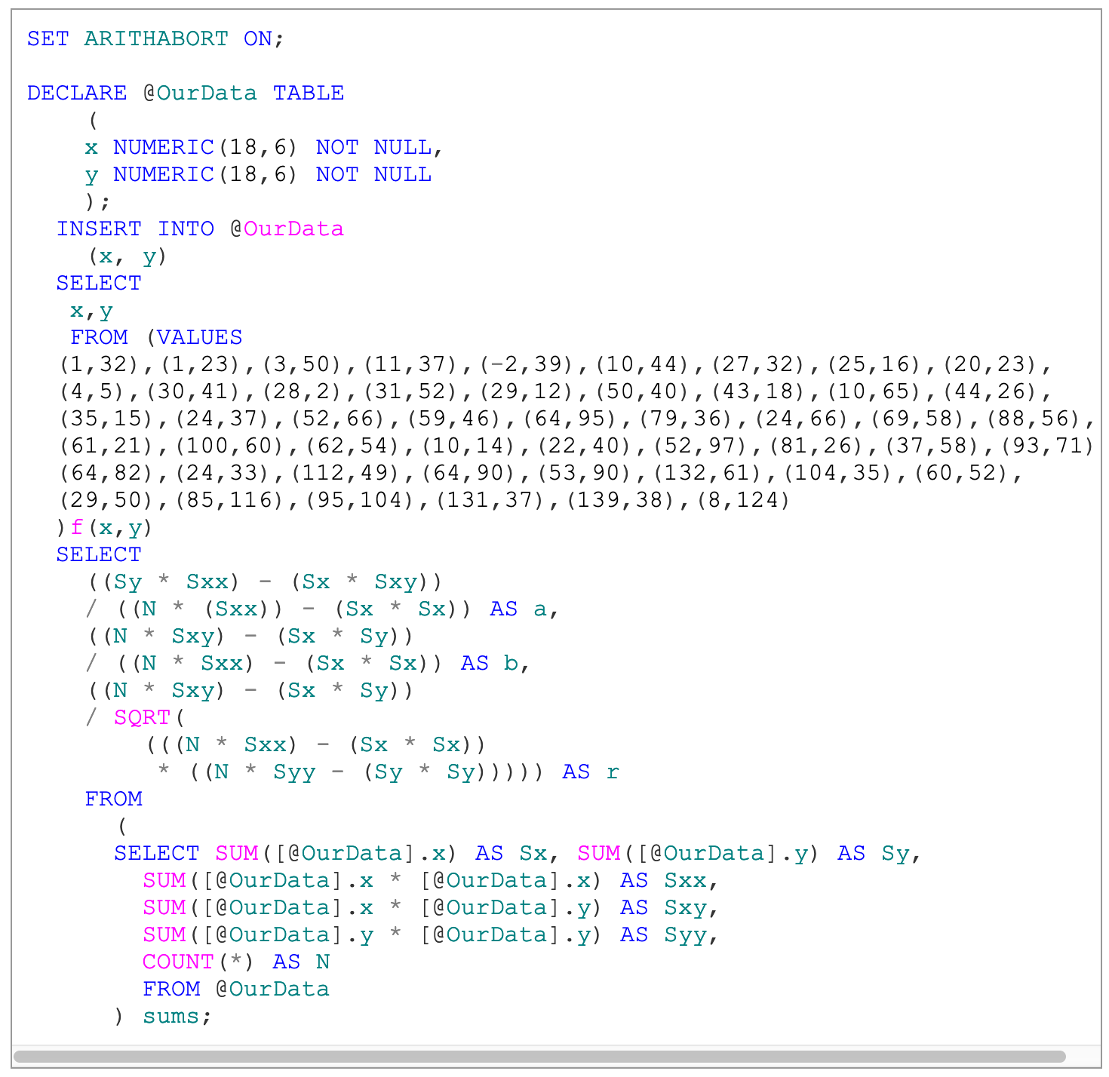
4. Correlation Coefficient
https://www.red-gate.com/simple-talk/blogs/statistics-sql-simple-linear-regressions/

Slide 230
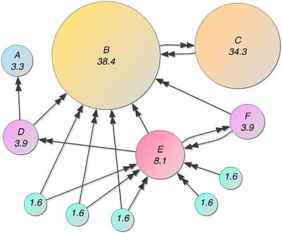
5. Page Rank
Recursive algorithm to assign weights to the nodes of a graph (Web Link Graph)
Weight for a node depends on the weights of the nodes that point to it
Typically done in iterations till “convergence”
Not obvious that you can do it in SQL, but:
Each iteration is just a LEFT OUTERJOIN
Stopping condition is trickier
Other ways to do it as well
https://devnambi.com/2013/pagerank.html

Slide 231
